Slide 1
Chest Pain Workshop Assignments
Guy Carmelli

Slide 2
Question 1

Slide 3
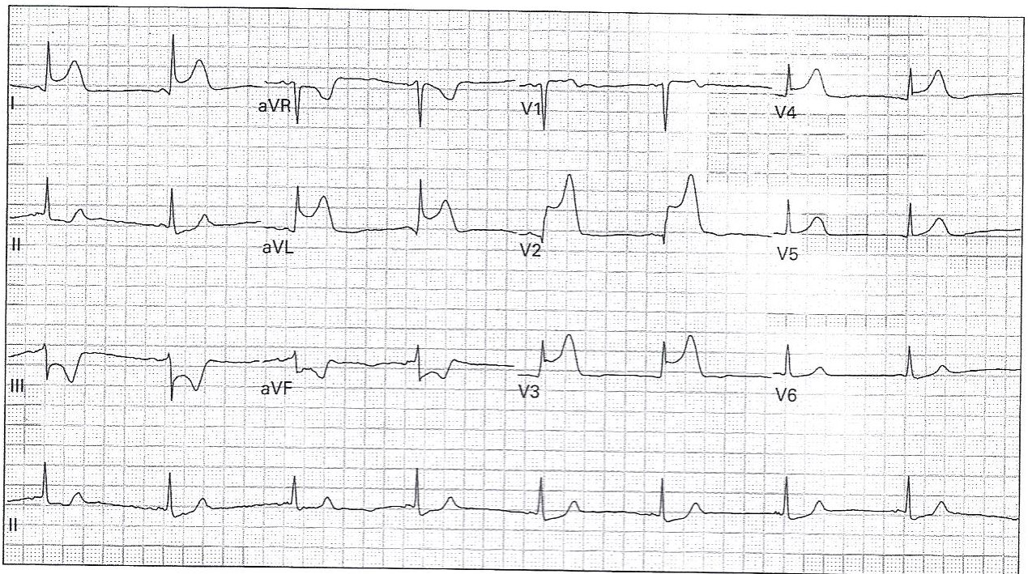
Question 1

Slide 4
Question 1
rate, rhythm, axis
intervals (PR, QRS, QT)
Q waves, ST changes, T inversions

Slide 5
EKG Basics

Slide 6
Rate

Slide 7
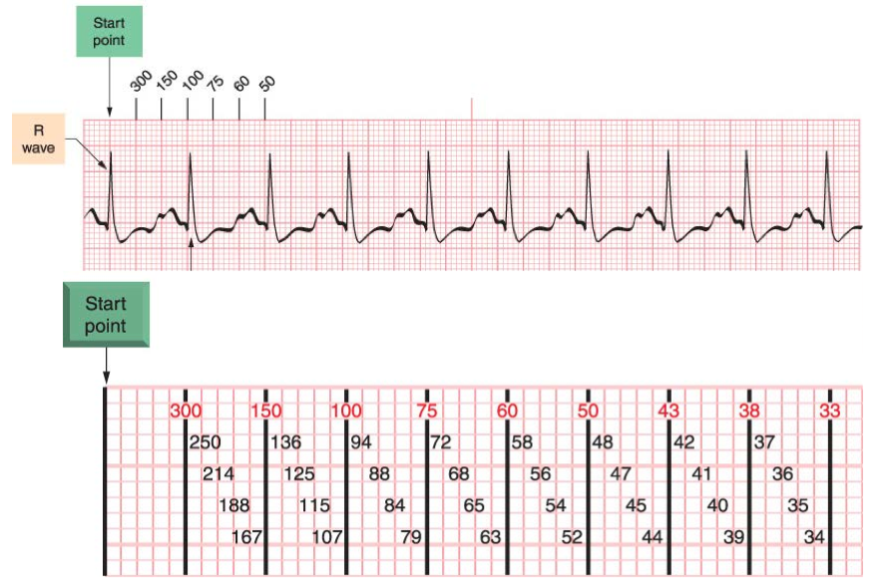
Rate

Slide 8
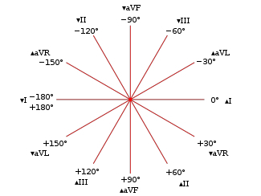
Axis

Slide 9
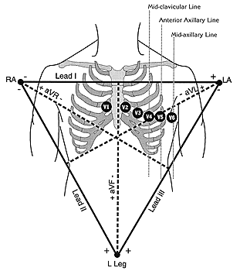
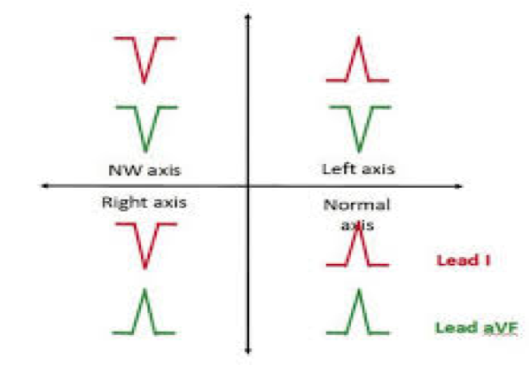
Axis
aVF
I

Slide 10
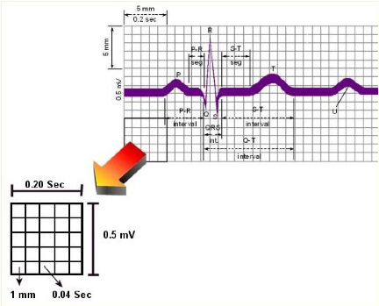

Slide 11
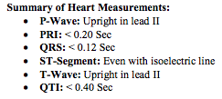
Intervals

Slide 12
Question 1
What does this EKG show?
Anterolateral MI
ST elevation in I, aVL and V2-5. Reciprocal ST depression in III and aVF (inferior leads).
Bonus: ST elevation primarily localized to leads I and aVL is referred to as a high lateral STEMI.

Slide 13
Question 1
2) Where is the lesion?
Proximal LAD or combined occlusion of the LAD with the RCA or L circ artery (then consider antero-infero-lateral MI).

Slide 14
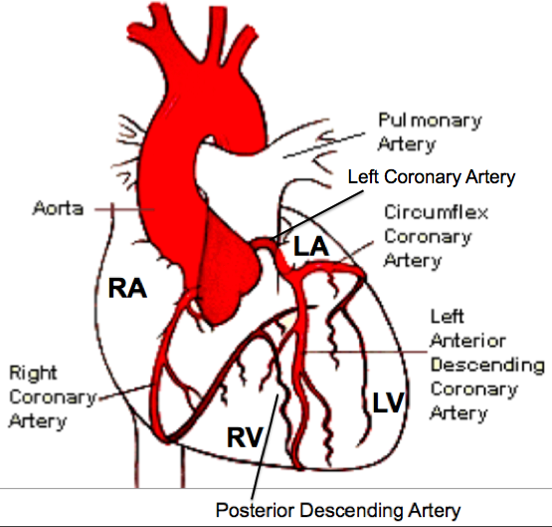
Question 1

Slide 15
Question 2

Slide 16
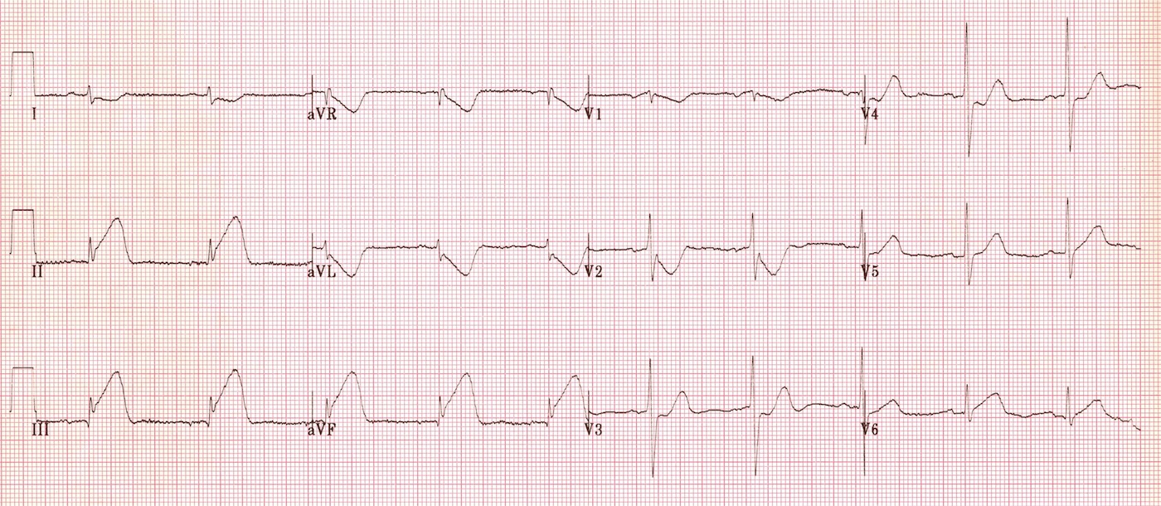
Question 2

Slide 17
Question 2
What does this EKG show?
Inferior wall MI
ST elevation in inferior leads II, III, aVF with reciprocal ST depression in leads I, aVL and V1-2)

Slide 18
Question 2
Where is the lesion?
RCA
If RV infract then prox. RCA
If some posterior extension, consider Left Circ.

Slide 19
LV
RV

Slide 20
Question 2
What other diagnostic is needed? What are you concerned about?
Right-sided precordial leads. Concern for RV infarction.

Slide 21
RV infarct
Right ventricular infarction complicates up to 40% of inferior STEMIs. Isolated RV infarction is extremely uncommon.
Hints to look for in all inferior MIs
ST elevation in V1 (more then in V2, which may be depressed)
ST elevation in lead III > lead II - because lead III is more “rightward facing” than lead II
Right sided leads

Slide 22
“Right-sided ECG” precordial ECG leads across the right side of the chest in mirror image to the normal ECG. The limb leads remain in an unchanged position
V4R is most sensitive lead

Slide 23
RV Infarct

Slide 24
Question 2
What intervention should be given with caution? Why?
Nitrates and other preload reducing agents should be given with caution because with an RV infarct pt is preload dependent and profound hypotension could occur.

Slide 25
Question 3

Slide 26
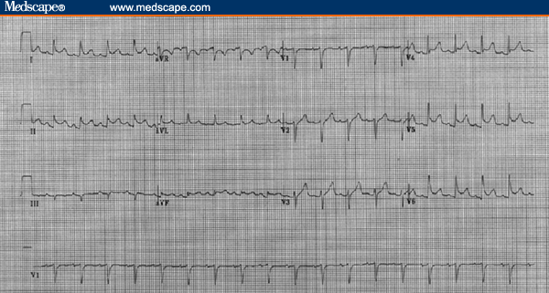
Question 3

Slide 27
Question 3
What is this EKG concerning for?
Pericarditis
ST elevation in inferior leads (II, III, aVF) with mild PR depression (highly specific for acute pericarditis)
Slight PR elevation with ST depression in aVR
If associated with pericardial effusion/tamponade:
Low QRS voltage
electrical alternans (lead V1?)
NO reciprocal ST depression. Reciprocal changes are more suggestive of an acute MI.

Slide 28
Pericarditis
Severe sharp left sided chest pain
Worse on breathing & lying flat
Better on sitting and leaning forward
May hear rub
ECG, IV, Blood Cx, Chest X-Ray, Echo
Analgesia: NSAIDS, Morphine

Slide 29
Pericarditis
Admit: Work-up for Etiologies & watch for complications: Effusion to Tamponade
Etiologies: Viral, MI, Post - MI, Trauma, Collagen Vascular Disease, Uremia, TB, Septic, Medications
Treat pain & inflammation
Treat underlying cause

Slide 30
Question 3
What other diagnostic will confirm the diagnosis?
Ultrasound to look for a cardiac effusion and tamponade physiology would be helpful.

Slide 31
Question 4

Slide 32
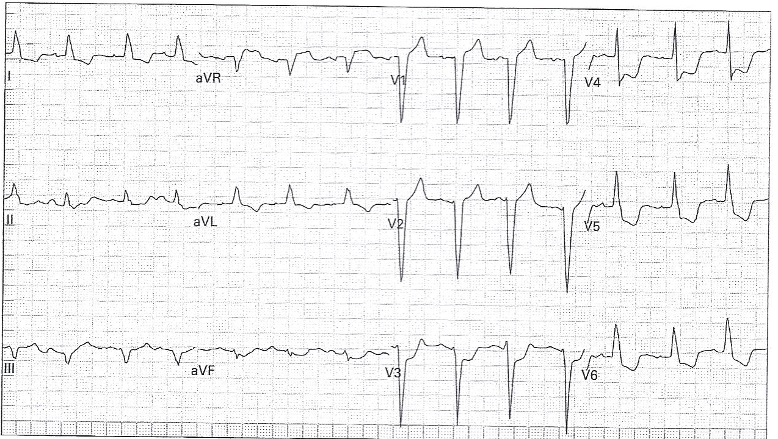
Question 4

Slide 33
Question 4
What does this EKG show?
LBBB with STEMI
ST depression in V3 meets the Sgarbossa criteria for acute MI (concordance).

Slide 34
LBBB
In LBBB, the normal direction of septal depolarization is reversed (becomes right to left), giving us
prolonged QRS >120ms,
leftward axis,
broad monophasic R wave in leads I and V6
deep wide S wave in lead V1
May have appropriate discordance: the ST segments and T waves always go in the opposite direction to the main vector of the QRS complex

Slide 35
Question 4

Slide 36
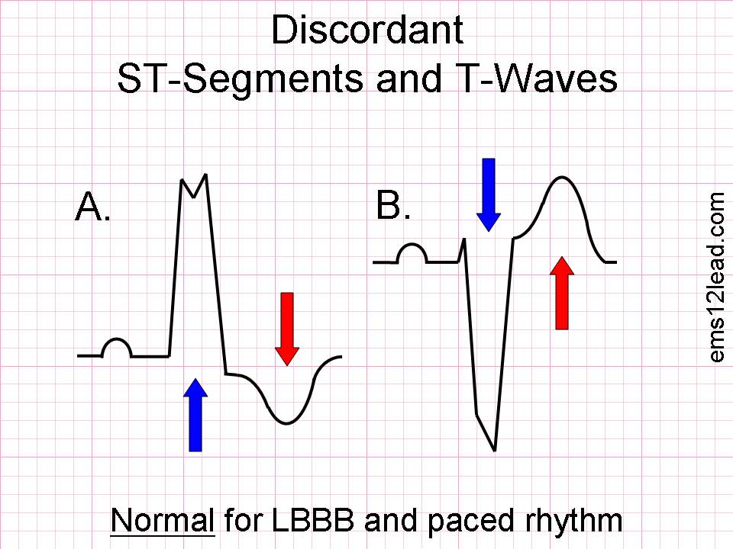
Appropriate Discordance

Slide 37
Question 4
Is there a STEMI? How can you tell?
Sgarbossa criteria (1996) –MI should be considered in the presence of LBBB when:
ST elevation of ≥1mm is concordant with the QRS complex
ST dep. of ≥1mm is concordance (V1-V3)
ST elevation of ≥5mm is discordant with the QRS complex

Slide 38
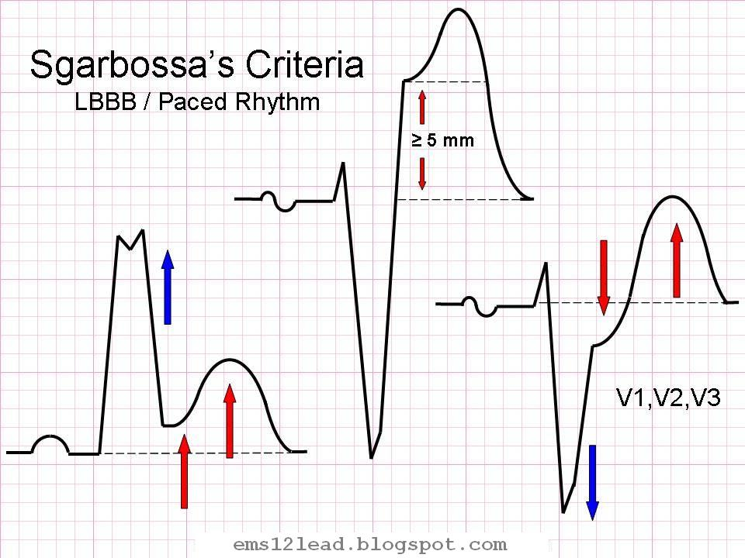
Question 4

Slide 39
Question 4

Slide 40
Question 5

Slide 41
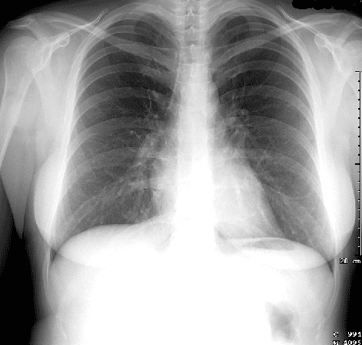
Question 5

Slide 42
Question 5
DRS ABCDE
Details, RIPE, Soft tissue and bones
Airway and mediastinum
Bones and soft tissue (or breathing)
Circulation
Diaphragm
Everything else, including lungs
Notes:
Details
Patient name, age / DOB, sex
Type of film – PA or AP, erect or supine, correct L/R marker, inspiratory/expiratory series
Date and time of study
RIPE
Rotation – medial clavicle ends equidistant from spinous process
Inspiration – 5-6 anterior ribs in MCL or 8-10 posterior ribs above diaphragm, poor inspiration?, hyperexpanded?
Picture – straight vs oblique, entire lung fields, scapulae outside lung fields, angulation (ie ’tilt’ in vertical plane)
Exposure (Penetration) – IV disc spaces, spinous processes to ~T4, L) hemidiaphragm visible through cardiac shadow.
Soft tissue and bones
Ribs, sternum, spine, clavicles – symmetry, fractures, dislocations, lytic lesions, density
Soft tissues – looking for symmetry, swelling, loss of tissue planes, subcutaneous air, masses
Breast shadows
Calcification – great vessels, carotids
Airway and mediastinum
Trachea – central or slightly to right lung as crosses aortic arch
Paratracheal/mediastinal masses or adenopathy
Carina & RMB/LMB
Mediastinal width <8cm on PA film
Aortic knob
Hilum – T6-7 IV disc level, left hilum is usually higher (2cm) and squarer than the V-shaped right hilum.
Check vessels, calcification.
Circulation
Heart position –⅔ to left, ⅓ to right
Heart size – measure cardiothoracic ratio on PA film (normal <0.5)
Heart borders – R) border is R) atrium, L) border is L) ventricle & atrium
Heart shape
Aortic stripe
Diaphragm
Hemidiaphragm levels – Right Lung higher than Left Lung (~2.5cm / 1 intercostal space)
Diaphragm shape/contour
Cardiophrenic and costophrenic angles – clear and sharp
Gastric bubble / colonic air
Subdiaphragmatic air (pneumoperitoneum)
Everything else
ETT, CVP line, NG tube, PA catheters, ECG electrodes, PICC line, chest tube
PPM, AIDC, metalwork
Breathing
Lung fields
Vascularity – to ~2cm of pleural surface (~3cm in apices), vessels in bases > apices
Pneumothorax – don’t forget apices
Lung field outlines – abnormal opacity/lucency, atelectasis, collapse, consolidation, bullae
Horizontal fissure on Right Lung
Pulmonary infiltrates – interstitial vs alveolar pattern
Coin lesions
Cavitary lesions
Pleura
Pleural reflections
Pleural thickening

Slide 43
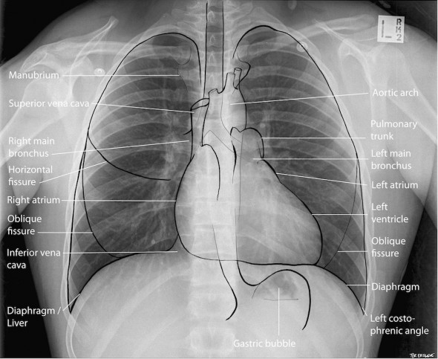

Slide 44
Question 6

Slide 45
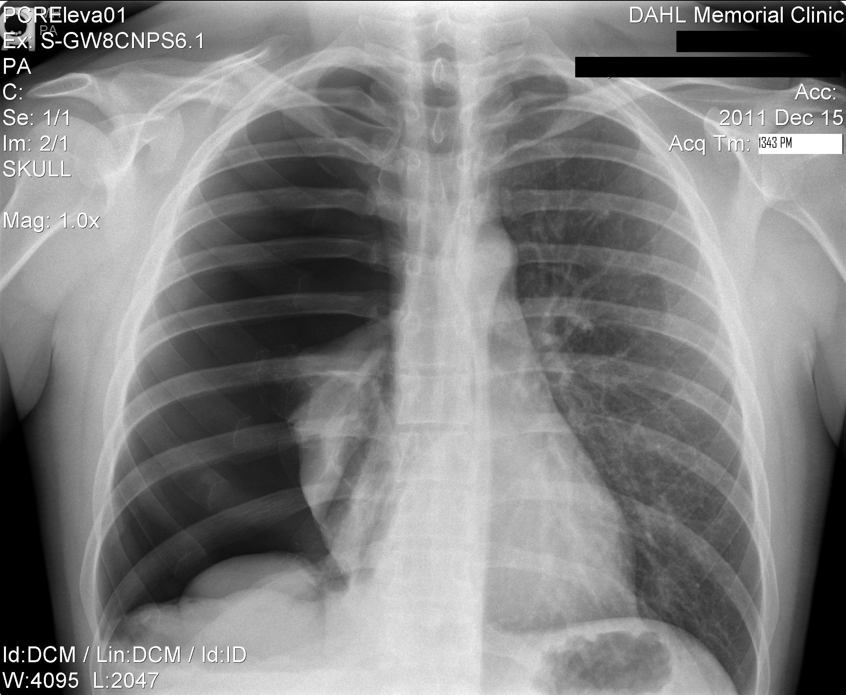

Slide 47
Thank You.

