Slide 1
Shortness of Breath
Justin Berkowitz, DO, MS and Guy Carmelli, MD

Slide 2
Objectives
Evaluation of SOB: the H & P
Important Differential diagnoses
What tests to order
Acute management
Disposition
Notes:
- Discuss important parts of history and physical, can’t miss or otherwise important diagnoses, helpful tests to guide/narrow differential, management priorities, how disposition can vary for seemingly similar presentations (asthma vs CHF).

Slide 3
Initial assessment
Sick or Not Sick
Primary survey
  ABC (IV, O2, Monitor)
Vitals
General appearance
Notes:
This should be well covered at this point in the students’ medical school career, so primary survey can just be briefly discussed.
Discuss normal vs high vs low for all VS: RR, HR, BP, T. Mention briefly what VS can be used to help differentiate etiology (resp vs cardiac vs other)
ECG - SOB can be a presenting symptom for cardiac disease
Advantages and disadvantages of US vs CXR; time to obtain, operator dependant, etc
Indications for intubation – Respiratory failure: oxygenation vs ventilation; airway protection; expected clinical course; oxygen management and delivery (sepsis)
(SO RAYMOND IS GOING OVER THIS STUFF, SO YOU CAN GO QUICKER AND FOCUS MORE ON THE SOB SPECIFIC STUFF, LIKE U/S VS CXR, WHEN TO INTUBATE…ETC)

Slide 4
History
Onset
Provocation/Palliation
Quality
Severity
Timing/frequency
Associated symptoms
Review of Symptoms
Notes:
Get answers from students for each aspect and how differences can be used to help determine etiology of symptoms.
(I PERSONALLY LIKE OPQRST. SO CAN YOU ADD IN ONSET, RADIATION AND QUALITY?)

Slide 5
The physical exam
What are you going to look for in the exam?
    Vital Signs
    Observation
    Auscultation
    Special exams
Notes:
Ask students what things to look for any why
Special exams: Egophony, tactile fremitus, whispered pectorliloquy

Slide 6
Other History-What is pertinent? Why?
PMH
PSH
Meds
Allergies
Fam Hx
Soc Hx
Notes:
PMH – particularly cardiac and respiratory conditions
PSH – recent surgery, cardiac
Meds – may help in elucidating history if pt doesn’t know specifics of conditions, OCPs, ACE-I
All – medication, food, and environmental, severity of reactions, h/o anaphylaxis
FH – cardiac, coagulopathies
SH – smoking, drugs(cocaine)
Travel history
(SO WHAT ARE PERTINENT FINDINGS IN THE HISTORY…DRUGS, SMOKING, RECENT TRAVEL, HORMONE USE…YOU HAVE TO ASK SPECIFICALLY ABOUT CONTROCEPTIVE, CAUSE MOST WOMEN DON’T CONSIDER THIS A MEDICATION)

Slide 7
Case 1

Slide 8
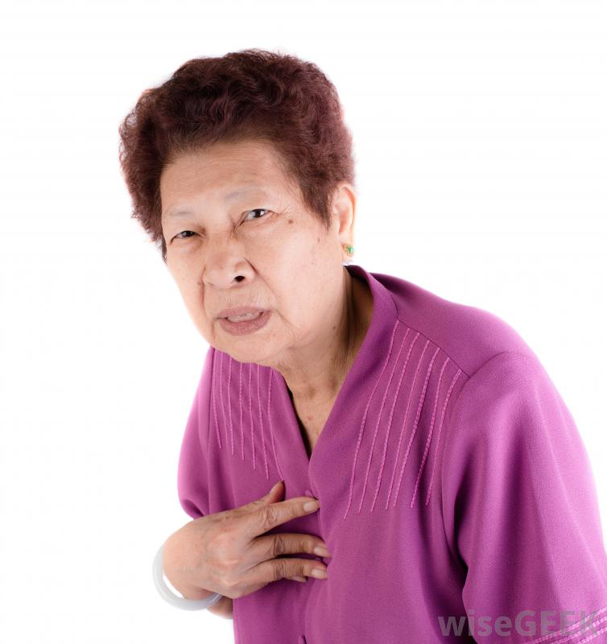
Case 1
65 yo F presenting acutely
SOB
Notes:
Acute pulmonary edema

Slide 9
ABCs
Airway
•She cannot speak, just gestures
Breathing
•You hear loud crackles all over, supracostal retractions, tachypneic
Circulation
•Pulses strong in all 4 extremities, pale
Notes:
(CAN YOU ADD IN ACTION ITEMS WHERE YOU CLICK AND DIFFERENT THINGS APPEAR..LIKE ASK- WHAT KINDS OF THINGS DO YOU LOOK FOR IN HER AIRWAY…IS SHE SPEAKING, DO YOU SEE ANY OBSTRUCTION..ETC. THEN ASK, WHAT DO YOU LOOK FOR FOR BREATHING- RESP RATE, BREATH SOUNDS, WORK OF BREATHING, EXTRAMUSCLE USE…ETC).

Slide 10
Vitals
HR: 130
BP: 185/105
RR: 34
Temp: 98.8
O2 Sat: 99% on 2LMP NC
Notes:
Ask students for comments/interpretation.

Slide 11
History (Limited)
65 yo F w/ h/o HTN, CAD awoke suddenly with SOB. She had been having increasing DOE x many months and requiring more pillows when sleeping.
Notes:
Again, ask students for comments/interpretation.

Slide 12
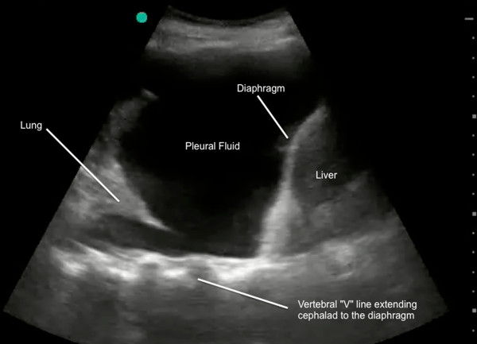
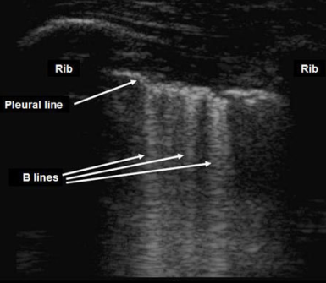
What next?
Sono
Notes:
(AGAIN, MAYBE ACTION LINK AFTER THE WHAT NEXT AND SEE WHAT THEY WANT?) Again, not entirely sure what you are thinking.

Slide 13
Now What?
Recap
  65 yo F, awoke with sudden SOB, hypertensive (185/105), tachypneic, diaphoretic, B-lines
  Sick or not sick?
SICK!
Differential Diagnosis
  APE/CHF, COPD, PE
Notes:
Next steps – CXR, EKG, labs, but point to make is to initiate treatment while waiting for tests; SL NTG, ASA, consider NTG gtt, BiPAP (CPAP), ACE-I, consider lasix

Slide 14
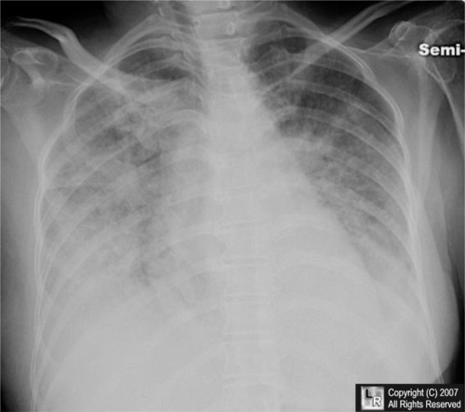
CXR
Notes:
Ask a student to interpret XR.
Pulmonary edema.

Slide 15
Next steps
What more are you going to elicit in the H&P?
Other tests?
      Labs? Why?
              CBC, CMP, BNP, troponin
      EKG? What are you looking for?
Notes:
Now that patient is more stable - OPQRST
What tests can help determine what caused, or didn’t cause, the acute decompensation? Utility of BNP?
EKG: ischemia, heart strain

Slide 16
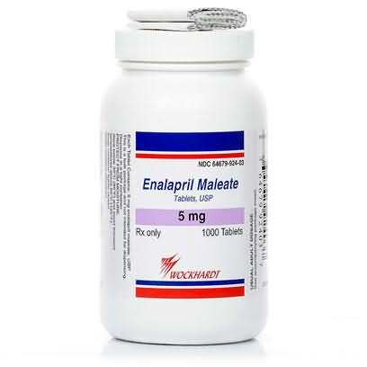
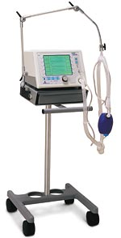

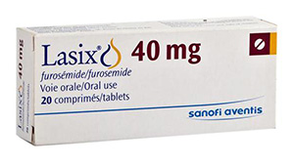
Management
Notes:
Discuss mechanisms of BiPAP (CPAP), NTG, ACE-I, diuretics in APE treatment. Also, don’t forget ASA.
(SO WHAT IS THE MANAGEMENT?)

Slide 17
Disposition
CCU/ICU
  Intensive monitoring or drips
Tele
  Now stable
Floor

Slide 18
Case 2

Slide 19
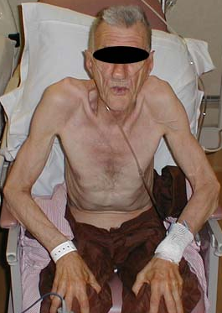
Case 2
76 yo M presenting acutely
SOB
Notes:
COPD exacerbation

Slide 20
ABCs
Airway
•Speaks 2 word sentences
Breathing
•Decreased air entry but symmetric, no abnormal lung sounds can be heard
Circulation
•Fingertips are blue, 2+ radial pulses

Slide 21
Vitals
HR: 110
BP: 105/65
RR: 38
Temp: 98.7
O2 Sat: 92% on 2LMP NC

Slide 22
History (limited)
76yo M, 50 pack-year smoker with some “heart problem”, presenting with 1 week worsening cough with sputum, and 1 day worsening chest tightness and respiratory distress

Slide 23
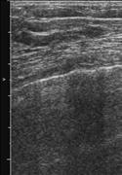
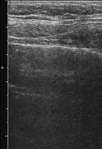
What next?
Sono?

Slide 24
Now what?
Recap
  76 yo M, long smoking history, productive cough, tight lung sounds, hypoxic, tachycardic, tachypneic
  Sick or not sick?
SICK!
Differential diagnosis
  COPD, CHF, PE, PNA

Slide 25
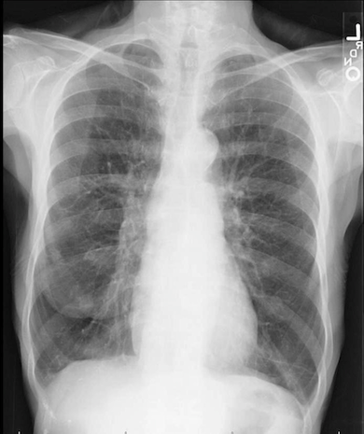
CXR

Slide 26
Any other tests?
Labs
What labs do you want and why? Need a reason for each test!
CBP, CMP, BNP?, troponin?
EKG

Slide 27
Treatment
What medicines do you want to administer to your patient?
Ipratropium, albuterol, steroids, abx, NIV

Slide 28
Case 3

Slide 29

Case 3
30 yo M, no PMH c/o SOB accompanied by sharp L side chest pain x ~2 hours. He is tall and skinny.
Notes:
(MAYBE FIND A PICTURE OF TALL AND SKINNY PERSON INSTEAD OF THIS IMMAGE WITH THAT GETTY IMAGE LOGO IN IT. IT LOOKS STRANGE)

Slide 30
ABCs
Airway
•Speaking in 3-5 word scentences
Breathing
•Mild tachypnea, splinting on L, wincing with deep breaths, decreased BS on L
Circulation
•Pulses strong in all 4 extremities

Slide 31
Vitals
HR: 102
BP: 105/65
RR: 22
Temp: 98.7
O2 Sat: 92% on RA

Slide 32
History (limited)
30 yo M, no PMH c/o SOB accompanied by sharp L side chest pain for about 2 hours. Symptoms started suddenly while walking. He denies, smoking, drinking, drugs, recent travel, and sick contacts.

Slide 33
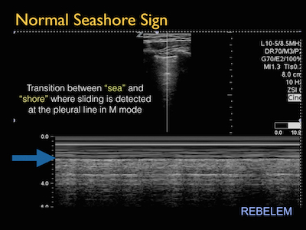
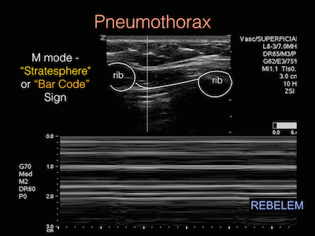
What next?
Sono
Notes:
(DO YOU HAVE AN A VIDEO CLIP OF LUNG SLIDDING. DO YOU HAVE M MODE OF SEASHORE SIGN VS BARCODE SIGN?)

Slide 34
Pneumothorax
What’s your next move?

Slide 35
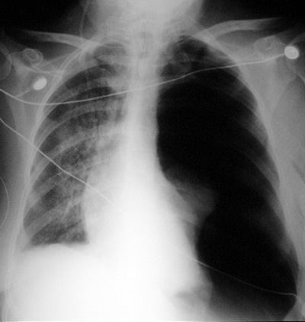
CXR

Slide 36


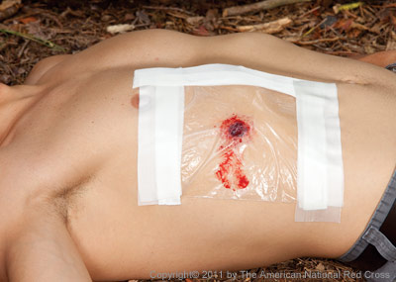
Types

Slide 37
Management
Conservative
  100% O2
Invasive
Tube thoracostomy

Slide 38
Case 4
Notes:
4

Slide 39
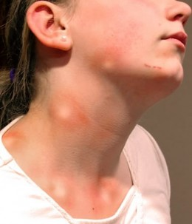
Case 4
15 yo F c/o trouble breathing.
Notes:
Anaphylaxis.

Slide 40
ABCs
Airway
•Speaking in 1-3 word sentences
Breathing
•Mild tachypnea, mild wheezing diffusely, BS diminished in all fields
Circulation
•Weak pulses, pale, cool, and clammy

Slide 41
Vitals
HR: 140
BP: 90/50
RR: 36
Temp: 98.7
O2 Sat: 94% on NRB

Slide 42
History (limited)
15 yo F with h/o asthma with SOB x 30 minutes. She was having lunch with her family at a restaurant when she suddenly started having trouble breathing and itching hives all over.

Slide 43
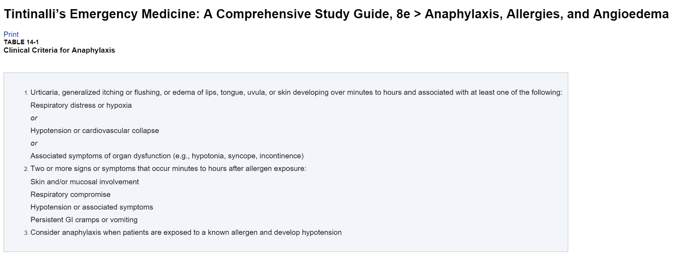
Diagnosis

Slide 44
What next?
Imaging?
Treatment?

Slide 45
Treatment
What do you want to do?
  Secure airway
What medicines do you want to give?
  Epi, H₁-Blocker, H₂-Blocker, steroids, IVF, nebs, mag

Slide 46
Summary
ABCs!!
In critical patients treat while you assess

Slide 47
Thank you!
Dr. Guy Carmelli
Dr. Ray Beyda
Notes:
(PLEASE ADD SUMMARY SLIDE AND THANK YOU AND REFERRENCES) .

Slide 48
References
Tintinalli’s Emergency Medicine: A Comprehensive Study Guide, 8e

Slide 49
Initial assessment
Primary survey
  ABC, IV, O2, Monitor (learn how to do each of these)
Abnormal vitals-what are you going to look for?
General appearance
ECG?-what are you looking for?
Ultrasound? CXR?
PICK A TREATMENT PATH. Intubation?
Notes:
This should be well covered at this point in the students’ medical school career, so primary survey can just be briefly discussed.
Discuss normal vs high vs low for all VS: RR, HR, BP, T. Mention briefly what VS can be used to help differentiate etiology (resp vs cardiac vs other)
ECG - SOB can be a presenting symptom for cardiac disease
Advantages and disadvantages of US vs CXR; time to obtain, operator dependant, etc
Indications for intubation – Respiratory failure: oxygenation vs ventilation; airway protection; expected clinical course; oxygen management and delivery (sepsis)
(SO RAYMOND IS GOING OVER THIS STUFF, SO YOU CAN GO QUICKER AND FOCUS MORE ON THE SOB SPECIFIC STUFF, LIKE U/S VS CXR, WHEN TO INTUBATE…ETC)

Slide 50
Start your resuscitation!
How do I start my resus?
What information do I want?
What observations can I make?
What tests do I want to order?
What treatments do I want to start?
Notes:
Again, answers from students.
Be sure to discuss PMH and onset in determing eitology.
What does the patient look like? Tiring out? Skin.
Treatments to start quickly, NTG, nebs, etc.

