Slide 1
Headache
Itamar Goldstein, MD
Resident, Internal/Emergency Medicine

Slide 2
Lecture Objectives
Classification
Etiologies and differential
History and Physical - high risk
Cases, tests and treatments

Slide 3
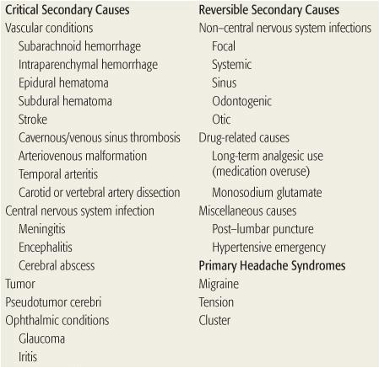
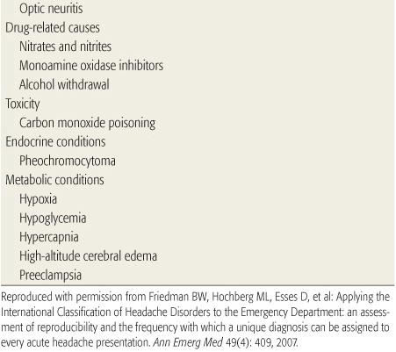
Classification

Slide 4
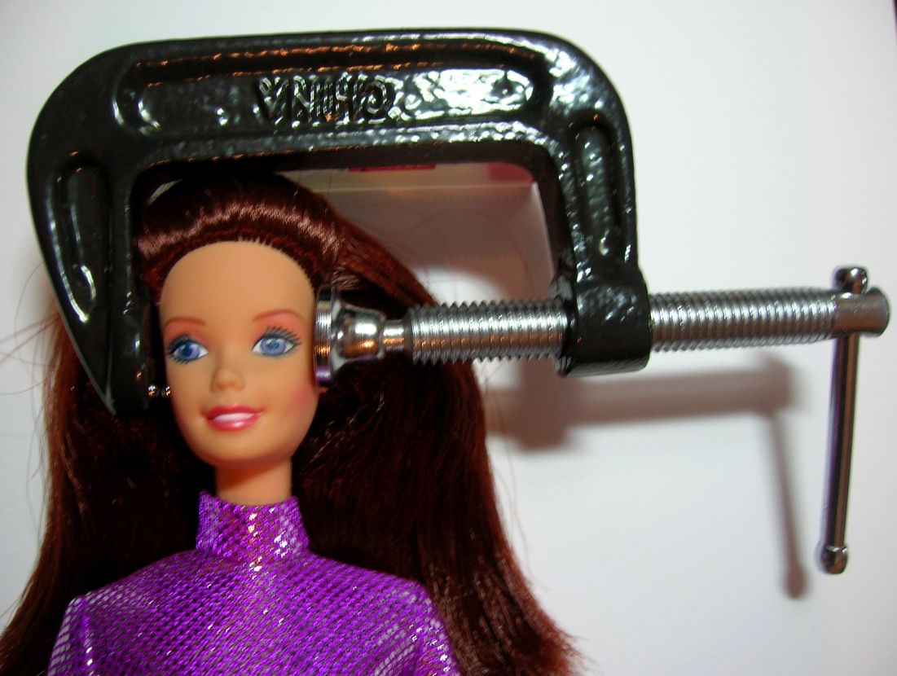
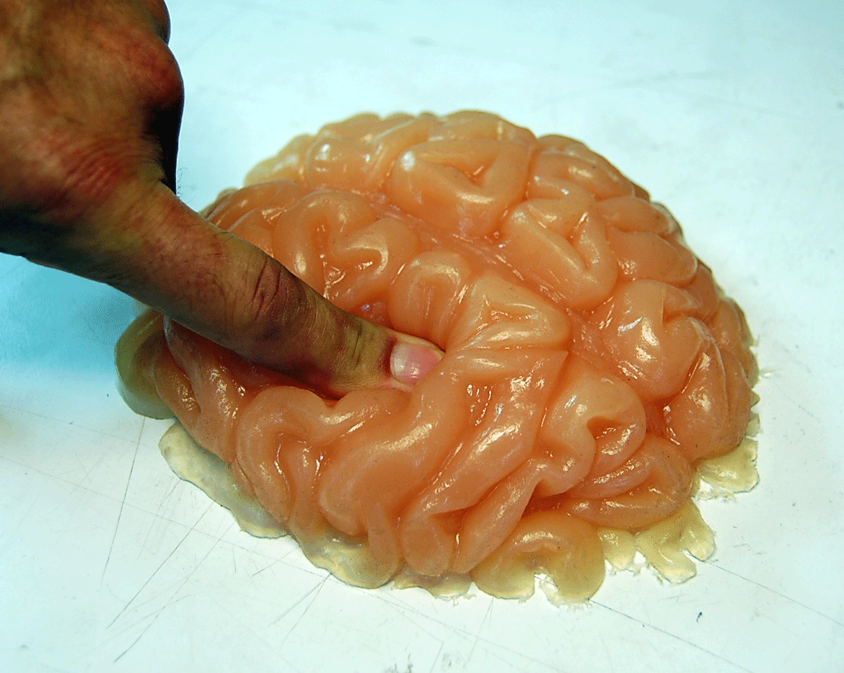
Secondary Critical
Primary
Vascular:
Subarachnoid
Subdural
Epidural
Intraparenchymal
CVA/TIA
Cavernous/venous sinus thrombosis
AV malformations
Temporal arteritis
Dissection (Carotid/vertebral).
Infectious:
Meningitis
Encephalitis
Abscess
Migraine
Tension
Cluster
Other:
Neoplastic (ICP)
Ophthal
IIH

Slide 5
High risk history - onset, trigger, trauma
SUDDEN ONSET - Especially during exertion:Bleed, dissection, thrombosis, glaucoma.
ANY Hx of TRAUMA - especially on anticoagulation/antiplatelets.
WORST in LIFE (THUNDERCLAP) - SAH / aneurysmal bleed.
NEW TYPE/FIRST HEADACHE - especially if history of headaches (change) or in adults with no history.
TRIGGER? - Exertion? Straining? Food/Alcohol? Medications?

Slide 6
High risk history - location
OCCIPITONUCHAL - meningeal irritation.
TEMPORAL - temporal arteritis
OPTIC - acute narrow angle glaucoma

Slide 7
High risk history - associated symptoms / other
FEVER - meningitis, encephalitis, abscess
NEUROLOGICAL DEFICITS - critical / primary (migraines)
JAW CLAUDICATION - temporal arteritis
FAMILY HISTORY OF… - aneurysm
ANTICOAGULATION/ANTIPLATELET - bleed

Slide 8
Physical - High risk findings
NEURO DEFICITS / VISUAL CHANGES - Don't forget gait.
ABNORMAL VITAL SIGNS
ANY SIGNS OF TRAUMA
FEVER - meningitis, encephalitis, abscess
MENINGISMUS - meningitis, SAH

Slide 9
Initial Eval
Unstable/Toxic/Obvious deficits
ABC
IV, O2, Monitor
Stable/stable VS Non-toxic
Stable/stable VS
Basic H&P
CT scan YES / NO
Labs
Interventions
Consult/Code
History (OPQRST, SAMPLE)
Physical (Good neuro exam)

Slide 10
Case I: Valsalva’s Revenge
A 54 year old man with no PMH p/w the worst headache of his life. It started while he was defecating and has been increasing in intensity. Associated with nausea and 1 episode of vomiting.
What do you call this headache?

Slide 11
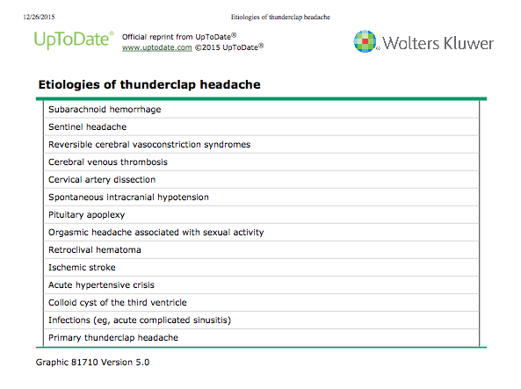
Differential?

Slide 12
What else would you like to know?
Hx: Sudden onset, During exertion, Worst in his life, associated with nausea and vomiting. Took baby ASA today. No Hx of AC.
Physical exam: Progressive AMS. No focal deficits.
Labs: No acute findings.
Any imaging?

Slide 13
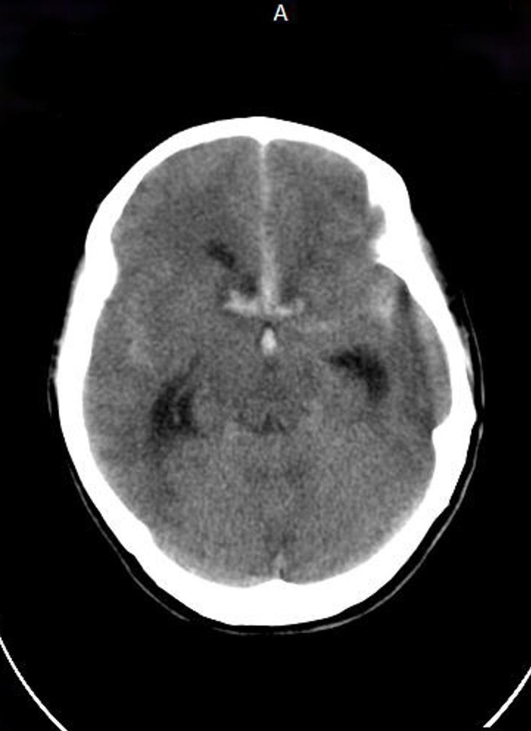
CT scan without contrast
Hyper-dense on CT
Fresh Blood

Slide 14
Subarachnoid Hemorrhage - Ruptured Aneurysm
SAH can be the result of a ruptured aneurism (75% of spontaneous) or trauma.
Often misdiagnosed (5-12%).
Family history of aneurysm increases chance 4 fold.
H&P (Over 50% have normal exam):
Sudden onset during exertion (thunderclap) - 11-25% of patients will have ruptured aneurism.
Occipital headache is most common location of pain.
Nausea, vomiting, AMS, syncope.

Slide 15
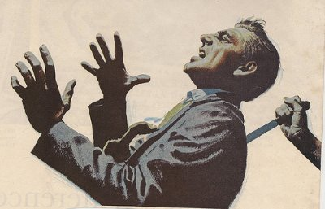
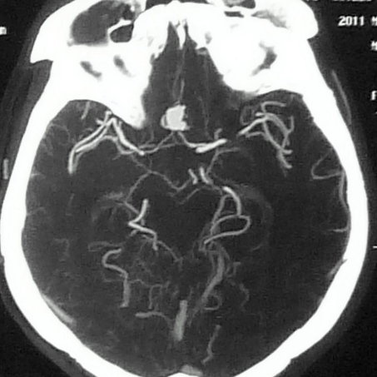
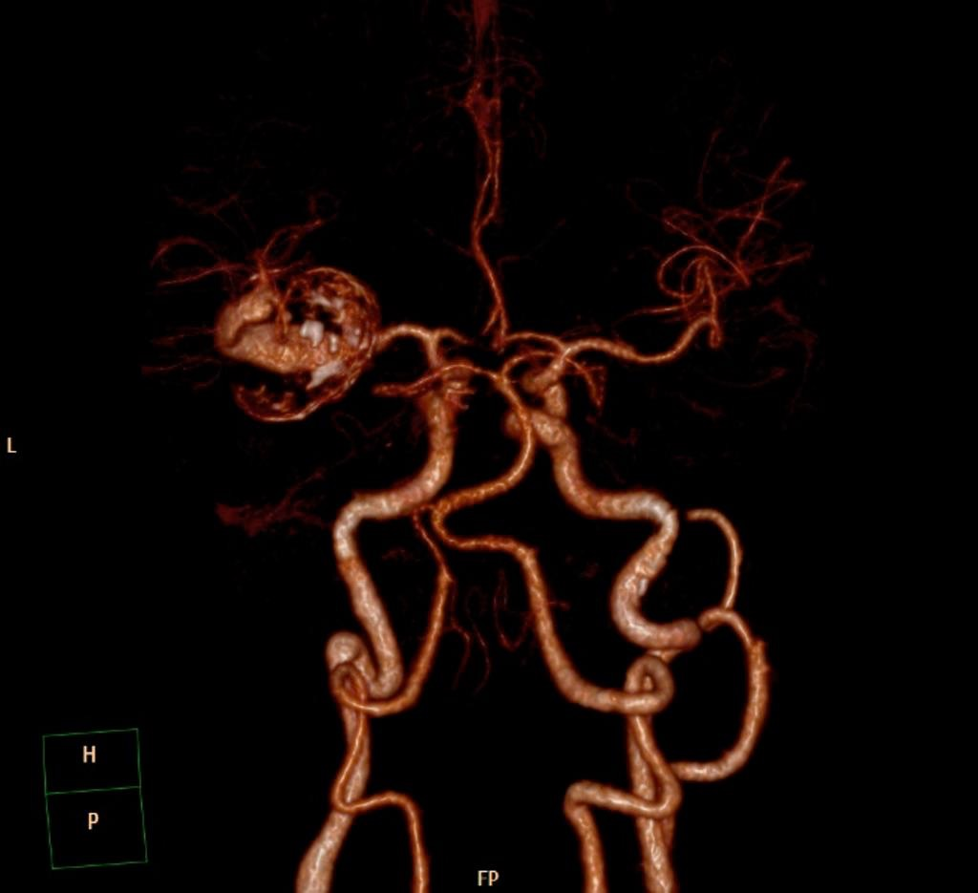
Subararachnoid Hemorrhage - Neuroimaging
Test of choice non-contrast CT scan - near 100% sensitivity within first 12 hours, 93% at 24 hours.
If negative: May need to perform LP (Xanthochromia, cell count ), CT angio or MRI/A.

Slide 16
“What is your management?!”
Aye Aye, demon monkey of Madagascar

Slide 17
Subarachnoid Hemorrhage - Management
Protect airway!
Reversal of ASA or AC.
Blood pressure control - ~MAP 130 (pain control and antiemetics!)
Head elevation
STAT neurosurgery consult/transfer.
Frequent neuro checks

Slide 18
Case II: Insane in the Membrane
A 22 year old college student presents c/o 4 days of a global headache associated with subjective fever and nausea.
Differential?

Slide 19
Differential
Infectious: viral syndrome, meningitis, intracranial abscess, encephalitis, dental infection, sinusitis, otitis.
Metabolic: Dehydration, electrolyte abnormality, anemia.
Primary: Status migrainosus.
Autoimmune: Lupus.

Slide 20
What else would you like to know?
Hx: Indolent headache, subjective fever, nausea, photophobia.
Physical exam: T: 101.4F, HR: 104, RR: 18, SpO2: 100%
Neuro exam: Non focal.
Neck stiffness.
Labs: WBC: 14.
Any other labs?

Slide 21
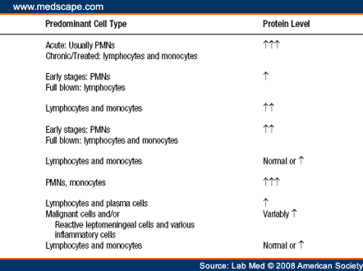
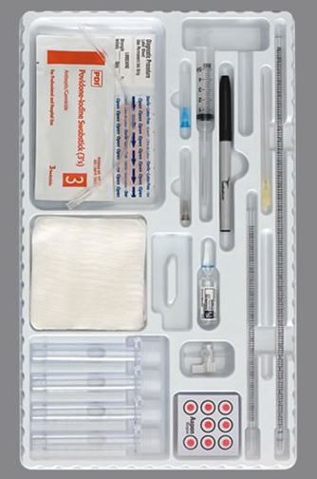
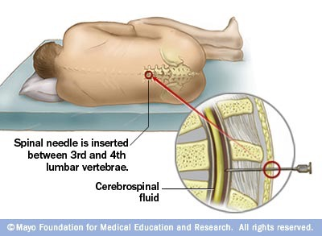

Slide 22
LP Results
Opening pressure 19 cm H2O (10-20)
Glucose 21mg/dL (Nl >60% serum)
Protein 298mg/dL (Nl <45% serum)
WBC 1003 cells/µL (0-5)

Slide 23
“What is your Diagnosis?”
Civil war general after whom the term “side burns” was coined
Maj Gen Ambrose Burnside

Slide 24
Bacterial Meningitis
Bacterial: S.pneumo (61%), Neisseria (16%), GBS (14%), Haemohilus (7%), Listeria (2%).
Mean age 39.
Pathophysiology: URI, hematogenous spread, meningeal seeding, inflammation and substantial cerebral edema.
Clinical features: fever, headache, AMS, neck stiffness, photophobia (seizures, cranial nerve palsies).
Risk factors: Alcoholism, otitis, sinusitis, immunocompromised, splenectomy, PNA, endocarditis, DM, unvaccinated (H.influenza, S.pneumo).

Slide 25
Treatment?
Treat first, ask questions (do the LP) later.
Steroids? only effective in adults if S. pneumo.
CT before LP? only if suspected ICP

Slide 26
Case 3: Doc, my brain hurts and my hand was weak.
A 36 yo woman presents c/o headache with R arm weakness and numbness that resolved before the ED.
What is your differential?

Slide 27
Differential
CVA/TIA
Complex Migraine/Hemiplegic Migraine.
Conversion disorder.
MS, Lupus (it can always be lupus).

Slide 28
What else do you want to know?
Hx:
No vascular risk factors.
Has Hx of these headaches both personally and in her family.
Unilateral headache with scalp tenderness.
Weakness resolved before the ED but headache persists.
Otherwise ROS neg.
Physical: VS wnl. Well appearing. Normal neuro exam. No afferent pupillary defect.

Slide 29
Diagnosis?

Slide 30
Complex Migraine (Hemiplegic Migraine)
Uncommon subtype of Migraine with aura.
Can be familial or sporadic.

Slide 31
Primary Headaches
Migraines
Unilateral
Scalp tenderness
Pulsating
Nausea and Vomiting
Photophobia
+/- Aura (usually visual)
Cluster
Conjunctival injection
Lacrimation
Nasal congestion
Rhinorrhea
Facial swelling
Miosis
Ptosis
Tension
Bilateral
Band-like distribution
Non throbbing
Dull
Increased pericranial muscle tenderness

Slide 32
Migraines - Treatment
Mild to moderate:
Simple analgesics +/- Caffeine — Tylenol, oral NSAIDS.
Antiemetics - Metoclopramide, compazine + Diphenhydramine.
Magnesium
Moderate to severe:
Triptans
NSAIDS (injectable) - Ketorolac
Antiemetics - Metoclopramide + Diphenhydramine.
Ergots
Dexamethasone (in addition).
AVOID OPIATES.

Slide 33
Take Home Messages
Primary versus Secondary headaches (always look for reversibility first).
Headaches are common - but you don’t want to miss the bad ones - Really.
Know your RED flags - thunderclap, occipital, deficits, new in adult, fever, abnormal neuro exam and more.
ABC / IV+O2+ Monitor—>Other interventions: CT head, neurology, LP, Medications.
Meningitis - Vanc + Ceftriaxone + Amp
SAH - Carry a high index of suspicion. Recognition is everything.
Primary headaches - Can have neurological deficits. History, including family Hx is key. Tx: antiemetics, antihistamines, Mg, NSAIDS.

