Slide 1
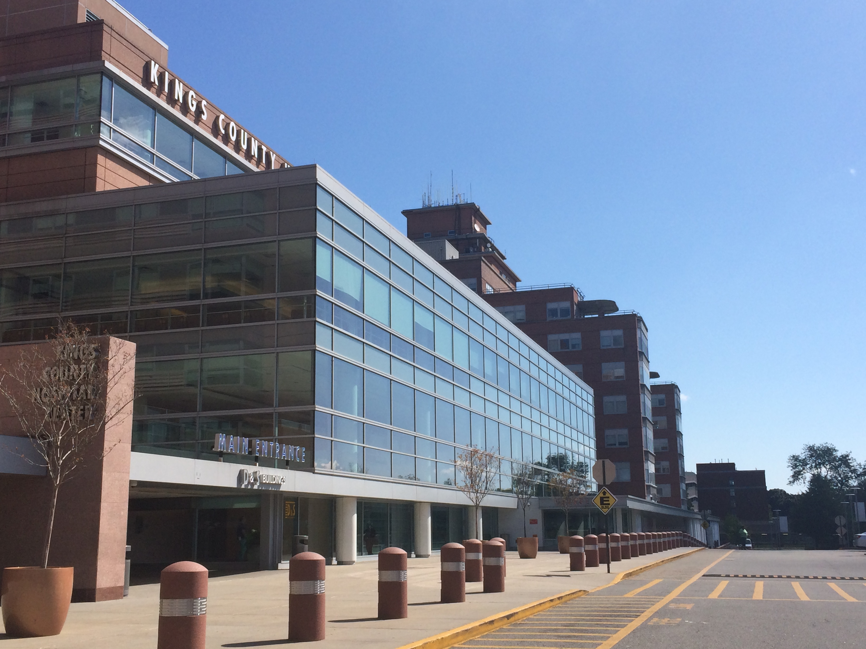
The Febrile Patient
Ben Kaufman Kings County / Downstate Emergency Medicine

Slide 2
Thanks
Dr. Smith, Dr. Marneni, Clinical Monsters

Slide 3
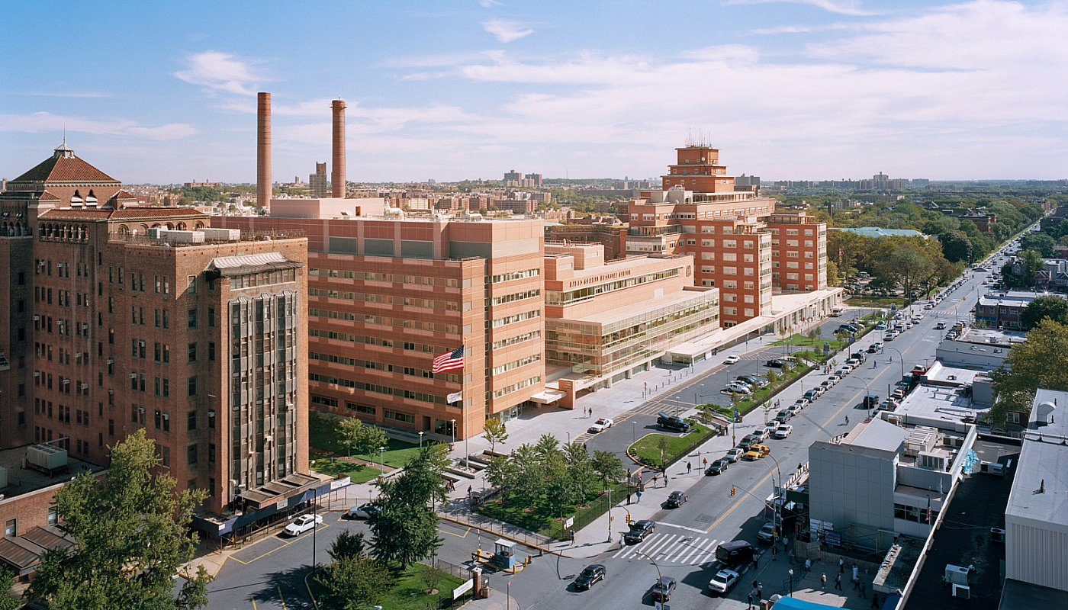
Fever in the Adult

Slide 4
Case
Triage
CC: 74F, hx DM, HTN BIBEMS from NH p/w AMS
VS: T 100.3 (oral) HR 110, BP 102/75, RR 30, O2 95%

Slide 5
Learning Objectives: Fever in Adult
Understand the dangerous etiologies of fever
Explain differential and know pertinent exam and ROS
Know the evaluation, treatment and disposition

Slide 6
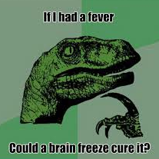
Introduction
Fever is sign caused by a spectrum of pathology.
It can be benign (young adults have <1% mortality)
Or serious (elderly have >7% mortality in 1 month)
Our role in EM is to identify serious causes & begin treatment.

Slide 7
Pathophysiology
Hypothalamus controls body set point (36-38 C)
Fever is defined by an increased set point.
- Initially causes “chills” (pt is colder than set point)
- Set point is reached (pt is warm to touch.)
- Fever “breaks” (pt sweats and returns to set point)
Process controlled by chemical mediators
- IL-1, IL-6 to hypothalamus → PGE2 released by COX

Slide 8
Spectrum of Inflammation
SIRS – 2 of T>38 or <36, HR >90, RR>20, WBC >12 or <4.
Sepsis – SIRS + source.
Severe sepsis – Sepsis + organ dysfunction
Septic Shock – Sepsis + clinical shock (AMS, ⬇BP)

Slide 9
Initial Approach
Goal: Rule out badness, find source, start treatment.
Emergent: Septic shock, meningitis, MI, PE, ICH, CVA
Stable → H&P, consider infectious, non-infectious
Unstable → ABCs, IV, O2, monitor
Septic → IVF, broad spectrum ABX, ibuprofen
Likely Sources:
Pediatrics: Ears & Throat
Elderly: Respiratory & Urinary
Bed Bound: Roll for ulcers
Younger M, F: Urinalysis, GU Exam
Pearls:
Rectal Temp
Jolt Accentuation
Proportional Tachycardia

Slide 10
Further Tests & Management
Labs: CBC, CMP, VBG, Blood Cx, UA, Ucx
Tests: EKG, CXR +/- CT Head, A/P, LP, RUQ US
Stable: Find source & treat (H&P, PE, testing)
Unstable: ABCs, IV, O2, monitor → RUSH, EGDT
Antibiotics CAP: Cef/Azithro
HCAP: Vanc/Zosyn/Azithro CNS: Vanc/Cefep +/- Amp, Acyclo
Renal: Cipro/Zosyn
Abdomen: Cef/Metro
Skin (MRSA): Vanc

Slide 11
Early Goal Directed Therapy
Rivers Trial (NEJM, 2001)
Mortality ⬇46%→30%
ProCESS Trial (NEJM, 2014)
Recent challenge to EGDT
Bottom Line:
Early recognition
Early IV Fluids
Early ABX

Slide 12
Rapid US for Shock & Hypotension

Slide 13
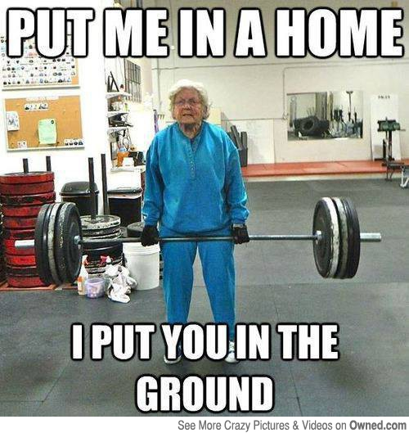
Back to the Case
IV, O2, monitor with labs, cultures sent started on Vanc/Zosyn, 2L IVF.
Labs showed elevated white count, bacteriuria and a rise in creatinine.
Pt was admitted to the floor for Severe Sepsis from her UTI.
Returned home after unremarkable hospital course.

Slide 14
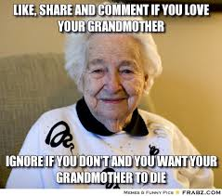
Take Home Points
Fever can have many sources, including non-infectious.
The SIRS criteria can identify the progression to sepsis.
Identify and treat the source in stable patients.
Sepsis should receive early IVF, ABX.

Slide 15
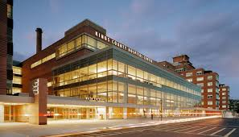
Pediatric Fever

Slide 16
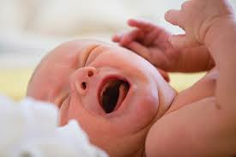
Case
Triage
CC: 31 day old w cough, runny nose, T 100.7 at home
VS: T 100.2, HR 149, BP 89/50, RR 40, O2 100%

Slide 17
Learning Objectives: Febrile Infants
Understand the dangerous etiologies of pediatric fever
Explain its differential and know pertinent exam and ROS
Know the historical evaluation, treatment and disposition
Grasp how this has changed recently and its implications

Slide 18
History of Present Illness
31d M, ex preemie at 35 wk p/w cough, rhinorrhea and fever.
Seen twice in past week at KCH ER for rhinorrhea and mucoid cough, treated with saline nebulizers and bulb suction on both visits, with noted loose stools on second visit two days ago. Today mom noticed baby felt warm, febrile rectally to 100.7 at home, 100.2 on presentation in the ER.
Since discharge, feeding well, appears playful to mom, sleeping on back in own crib, making wet diapers, non-toxic. Mom denies maternal infections, complicated pregnancy, pulling at ears, eye discharge, productive cough, vomiting, diarrhea, clutching at belly, rashes or skin changes.

Slide 19
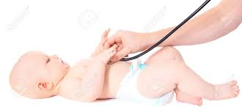
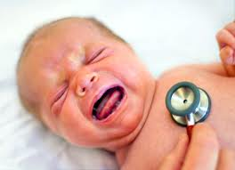
Physical Exam
VS: T 100.2, HR 149, BP 89/50, RR 40, O2 100% Gen: Awake, alert, NAD, crying, consolable, non-toxic HEENT: AFOFS, NCAT, PERRLA, EOMI, TMs clear b/l, nasal d/c Neck: Supple, no LAD, throat unremarkable CV: RRR no m/r/g, cap refill < 2 sec, +fem/brachial pulses Resp: Transmitted upper airway BS, no w/r/r, good effort Abd: Soft, NTND, +BS, no masses, no HSM, diaper clean Ext: Nl ROM, inspection in b/l UE, LE Skin: No noted rashes or lesions Neuro: CN intact, +Moro, +Grasp, +Suck, upgoing Babinski
Expectations
Reality

Slide 20
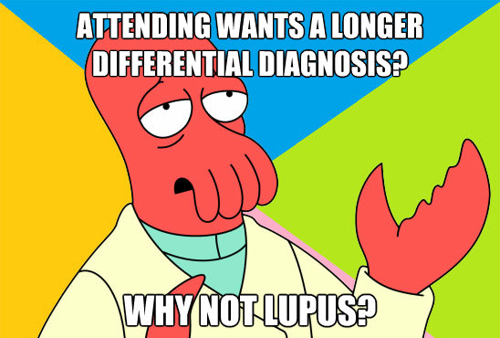
Differential Diagnosis
Common Emergent Other
Bronchiolitis Viral Infection Urine infection
Otitis Media
Bacteremia
Meningitis
Pneumonia Gastroenteritis
Cellulitis
Osteomyelitis
HSV
Vasculitic
Neoplastic
Drug ingest
Metabolic
Autoimmune
Endocrine Other

Slide 21
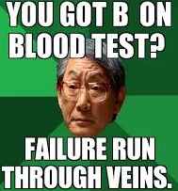
Tests & Management
CBC: 6.7>11/32<218, no band cells or left shift
BMP: 136/5/103/25/5/0.2/84 LFT: 37/17/248
UA: Clear, -LE, -nit, -glucose, -ketones, -WBC, -RBC.
RSV: Negative, Influenza A&B: Negative
Blood, Urine, Stool Cx: Pending
CXR: Unremarkable
ED Course: Afebrile at 37C s/p ibuprofen, lumbar puncture deferred to inpatient team, admitted to pediatrics no ABX.

Slide 22
Pediatric Fever
20% of visits to the Pediatric ER are due to fever
20% are fever w/o a source (FWS)
7% due to serious infections (SBI)

Slide 23
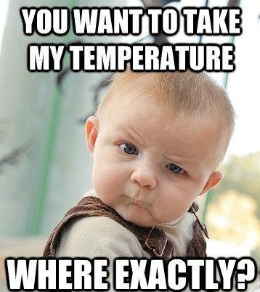
Pediatric Fever
Fever: Rectal temp >38C Fever w/o Source: No source after H&P
Fun Facts: Mean temp is 37C 38C is 2 SD above Rectal is 1F (.6C) > Oral
38 C 100.4 F 39 C 102.2 F 40 C 104.0 F

Slide 24
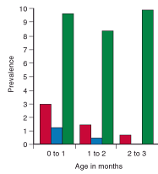
The Problem
What is the chance my baby is sick? UTI: 3-8% Bacteremia: 2-3%* Meningitis: 1% HSV: 0.3%

Slide 25
Bacteria
Pathogens differ according to age
0-2 wk: GBS, E Coli, Listeria, Entero, HSV
2-6 wk: GBS, E Coli, Listeria, HSV, Entero, Pneumo, HIB
6-8 wk: Pneumo, Meningococcus, HIB

Slide 26
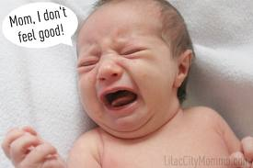
Examination
Illness manifests differently in babies.
Physician instinct and parental concern
Danger if petechiae, cyanosis, tachypnea, T > 40C
HPI PO Intake, UOP ∆ Activity ∆, N/V/D Immunizations, Sleep ∆
PMH Birth History, NICU Pregnancy Comps Maternal Infections
Exam Vitals, Appearance Fontanelles, Ears, Throat Rash, Reflexes, Neuro

Slide 27
Tests and Treatment
Full Sepsis: CBC, CMP, BCx, UA, UCx, CXR, LP
Historically <3 mo febrile child: admit & IV ABX
Costly & invasive. Studied in early 1990’s
Criteria: CBC, UA, Clinical +/- LP, CXR

Slide 28
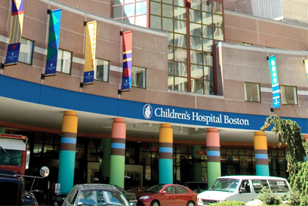
Boston Criteria
Infants 1-3 mo T > 38C
CBC, BCx, UA, UCx, CXR, LP
High risk: Admit with IV ABX
Low risk: D/C to PMD, IM Cef 24 &48 hrs
Of 503 low risk infants, 5% had SBI.
All did well on outpt ABX.

Slide 29
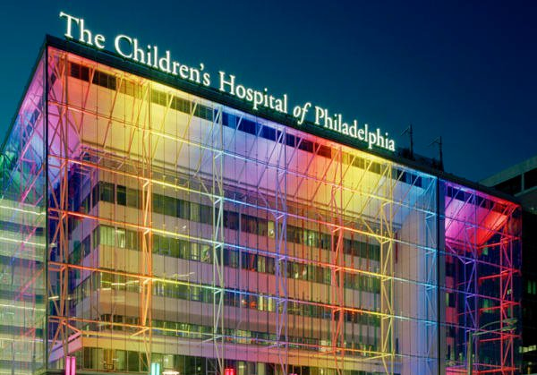
Philadelphia Criteria
Infants 1-2 mo T > 38.2C
CBC, BCx, UA, UCx, CXR, Stool, LP
High risk: Admit with IV ABX
Low risk: No ABX, observe in hospital or D/C to PMD
Of low risk infants, none had SBI.
All did well with observation.

Slide 30
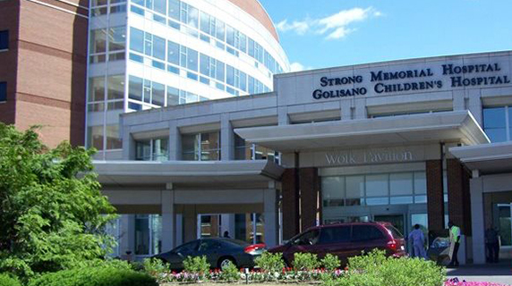
Rochester Criteria
Infants 0-2 mo T > 38C
CBC, BCx, UA, UCx
High risk: Admit with IV ABX
Low risk: No ABX, observe in hospital or IM Cef & d/c.
Of low risk infants, one had SBI.
All did well with observation.

Slide 31
LP ALL NO ABX STRICT, CHEAP
NO LP OR ABX MISS 1% SBI
LP ALL ABX ALL

Slide 32
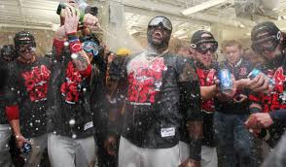

Slide 33
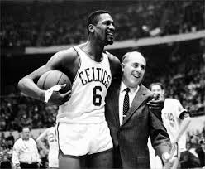

Slide 34
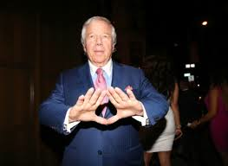
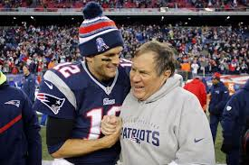

Slide 35
Controversy
80% of Pediatric EM programs don’t follow guidelines
50% of Pediatric EM programs have no policy
85% of fellowship PDs want new guidelines

Slide 36
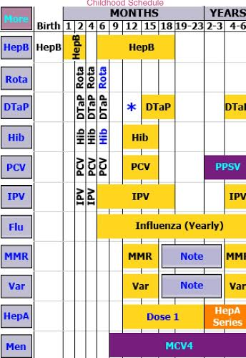
Vaccinations
Prenatal: Test and treat Group B Strep
Birth: Hep B, Erythromycin
2 mo: Rota, DTaP, Hib, PCV13, IPV
Decrease bacteremia from 5% to <1%

Slide 37
Recent Changes
H Flu: Hib vaccine (1988) decreased bacteremia 99%
S Pneumo: PCV 13 (2010) decreased bacteremia 90%
Occult bacteremia ↓ 3% to <.5%
RSV, Influenza rapid test: result before pt leaves ER.

Slide 38
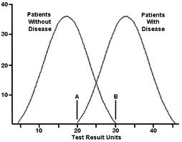
Risk Stratification
Very Low: Full sepsis work up with LP
Low: Full sepsis work up no LP
Minor: Partial work up
Risky: No tests

Slide 39
Preferences
Parents:
Physicians:
Population Interventions Compliance 31-90 days: ill Full sepsis evaluation 36%
ABX, hospitalization
31-90 days: well WBC, urinalysis 42%

Slide 40
Management
1 mo: Full sepsis work up w LP, admit, IV ABX
1-3 mo: CBC, BCx, UA, UCx +/- stool (diarrhea), CXR (resp)
Consider LP, ABX, admission vs. discharge with close follow up
Consider:
Poor follow up: No PMD, No English
RSV or flu positive: 2-3x less likely SBI
No LP if ABX given even if negative
UTI: Kidney US (hydro → cystography)

Slide 41
Antibiotics
0-21 days: IV Ampicillin / Cefotax / Acyclovir
22-28 days: IV Ampicillin / Cefotax
29-58 days: IV Cefotax
Consider:
Vancomycin: Ill-appearing or >8 WBC in CSF
Acyclovir: Ill-appearing, seizures, neuro def, vesicles, LFT
Ceftriaxone displaces bilirubin, can give in >1 mo

Slide 42
Back to the Case
Hospital Course:
31d M, ex preemie at 35 wk admitted for 3 days for bronchiolitis. Initially presented to the ED with cough, rhinorrhea, temp of 100.7 rectally. In the ED, partial sepsis work up done with reassuring CBC, CMP & UA.
On the floor continued on saline nebulizers and nasal suctioning. Blood and urine cultures showed no growth, and the patient was afebrile, by hospital day three, clinically improved and stable for discharge.

Slide 43
Take Home Points
Fever should be taken seriously in unvaccinated infants
Neonates should be admitted for IV antibiotics.
Philadelphia, Boston, Rochester for unvaccinated infants
Recent vaccine advances lower risk of serious infection
If discharging, ensure good follow up.

Slide 44
Importance of Vaccines

Slide 45
Geography

Slide 50
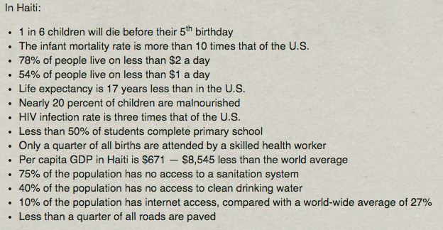
Health Statistics

Slide 51
Hospital
65,000 patients annually

Slide 52
Waiting Room

Slide 53
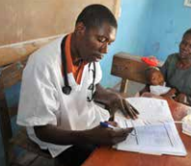
5

Slide 54
Vaccinations

Slide 59
Statistics
50% fully vaccinated

Slide 60
$10

Slide 62
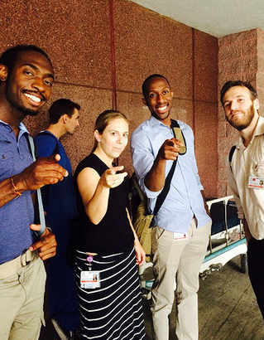

Slide 63
References
Tintinalli, Judith E., and J. Stephan. Stapczynski. "Fever and Serious Bacterial Illness" Tintinalli's Emergency Medicine: A Comprehensive Study Guide. 7th ed. New York: McGraw-Hill, 2011. 750-755. Print.
Byington CL, Enriquez FR, Hoff C, et al. Serious bacterial infections in febrile infants 1 to 90 days old with and without viral infections. Pediatrics. 2004;113:1662­1666.
Variation in Care of the Febrile Young Infant <90 Days in US Pediatric Emergency Departments, Paul L. Aronson, MD, Cary Thurm, PhD, Elizabeth R. Alpern, MD, MSCE, Evaline A. Alessandrini, MD, MSCE, Derek J. Williams, MD, MPH, Samir S. Shah, MD, MSCE, Lise E. Nigrovic, MD, MPH, Russell J. McCulloh, MD, Amanda Schondelmeyer, MD, Joel S. Tieder, MD, MPH, and Mark I. Neuman, MD, MPH PEDIATRICS Vol. 134 No. 4 October 1, 2014 pp. 667 -677 (doi: 10.1542/peds.2014-1382)
Levine DA, Platt SL, Dayan PS, et al. Risk of serious bacterial infection in young febrile infants with respiratory syncytial virus infections. Pediatrics. 2004;113:1728­1734.
"Two Fevers, One Out-of-Date Protocol." Two Fevers, One Out-of-Date Protocol. N.p., n.d. Web. 17 Mar. 2015.Pediatric Emergency Medicine, Rothrock
"Evaluation of Fever in Infants and Young Children." - American Family Physician. N.p., n.d. Web. 17 Mar. 2015.
"The Children's Hospital of Philadelphia." The Children's Hospital of Philadelphia. N.p., n.d. Web. 17 Mar. 2015. http://www.chop.edu/clinical-pathway/febrile-young-infant-clinical-pathway
Van den Bruel A, Haj-Hassan T, Thompson M, Buntinx F, Mant D; European Research Network on Recognising Serious Infection Investigators. Diagnostic value of clinical features at presentation to identify serious infection in children in developed countries: a systematic review. Lancet. 2010;375(9717):834–845.
Performance of Low-Risk Criteria in the Evaluation of Young Infants with Fever: Review of the Literature, Pediatrics 2010
Incorporating patient preferences into practice guidelines: management of children with fever without source. Oppenheim PI1, Sotiropoulos G, Baraff LJ. Ann Emerg Med. 1994 Nov;24(5):836-41.

