Slide 1
Chest Pain & Shortness of Breath
Justin Berkowitz DO, MS, Guy Carmelli MD
Raymond Beyda MD, Michael Griesinger MD

Slide 2
Objectives
Emergency Department management of Chest Pain and Shortness of Breath
Differential Diagnoses
History and Physical
Case
Tests
Management
Disposition
Notes:
This should be well covered at this point in the students’ medical school career, so primary survey can just be briefly discussed.
Discuss normal vs high vs low for all VS: RR, HR, BP, T. Mention briefly what VS can be used to help differentiate etiology (resp vs cardiac vs other)
ECG - SOB can be a presenting symptom for cardiac disease
Advantages and disadvantages of US vs CXR; time to obtain, operator dependant, etc
Indications for intubation – Respiratory failure: oxygenation vs ventilation; airway protection; expected clinical course; oxygen management and delivery (sepsis)
(SO RAYMOND IS GOING OVER THIS STUFF, SO YOU CAN GO QUICKER AND FOCUS MORE ON THE SOB SPECIFIC STUFF, LIKE U/S VS CXR, WHEN TO INTUBATE…ETC)

Slide 3
Initial assessment
Primary survey
ABC (IV, O2, Monitor)
Vitals
Sick or Not Sick
Notes:
This should be well covered at this point in the students’ medical school career, so primary survey can just be briefly discussed.
Discuss normal vs high vs low for all VS: RR, HR, BP, T. Mention briefly what VS can be used to help differentiate etiology (resp vs cardiac vs other)
ECG - SOB can be a presenting symptom for cardiac disease
Advantages and disadvantages of US vs CXR; time to obtain, operator dependant, etc
Indications for intubation – Respiratory failure: oxygenation vs ventilation; airway protection; expected clinical course; oxygen management and delivery (sepsis)
(SO RAYMOND IS GOING OVER THIS STUFF, SO YOU CAN GO QUICKER AND FOCUS MORE ON THE SOB SPECIFIC STUFF, LIKE U/S VS CXR, WHEN TO INTUBATE…ETC)

Slide 4
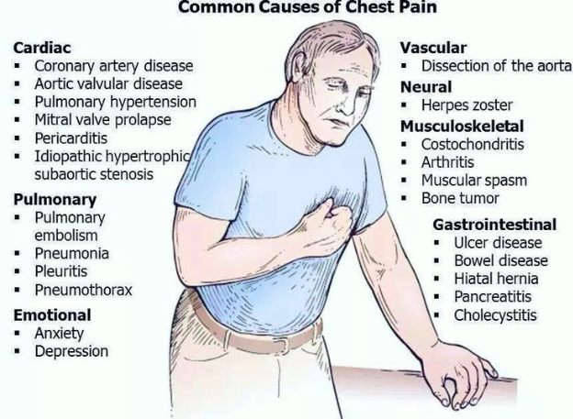
Common Causes of Chest Pain
Notes:
Briefly discuss how to approach the chest pain patient in terms of systems, anatomy, etc.

Slide 5
History
Onset
Provocation/Palliation
Quality
Severity
Timing/frequency
Associated symptoms
Review of Symptoms
Notes:
Get answers from students for each aspect and how differences can be used to help determine etiology of symptoms.
(I PERSONALLY LIKE OPQRST. SO CAN YOU ADD IN ONSET, RADIATION AND QUALITY?)

Slide 6
Other History-What is pertinent? Why?
PMH
PSH
Meds
Allergies
Fam Hx
Soc Hx
Notes:
PMH – particularly cardiac and respiratory conditions
PSH – recent surgery, cardiac
Meds – may help in elucidating history if pt doesn’t know specifics of conditions, OCPs, ACE-I
All – medication, food, and environmental, severity of reactions, h/o anaphylaxis
FH – cardiac, coagulopathies
SH – smoking, drugs(cocaine)
Travel history
(SO WHAT ARE PERTINENT FINDINGS IN THE HISTORY…DRUGS, SMOKING, RECENT TRAVEL, HORMONE USE…YOU HAVE TO ASK SPECIFICALLY ABOUT CONTROCEPTIVE, CAUSE MOST WOMEN DON’T CONSIDER THIS A MEDICATION)

Slide 7
The physical exam
What are you looking for?
Vitals
General Appearance
Conjunctival pallor
Mucous membranes
JVD
Heart Sounds
Respiratory Exam
Abdominal Exam
Extremities
Notes:
Ask students what things to look for any why
Special exams: Egophony, tactile fremitus, whispered pectorliloquy

Slide 8
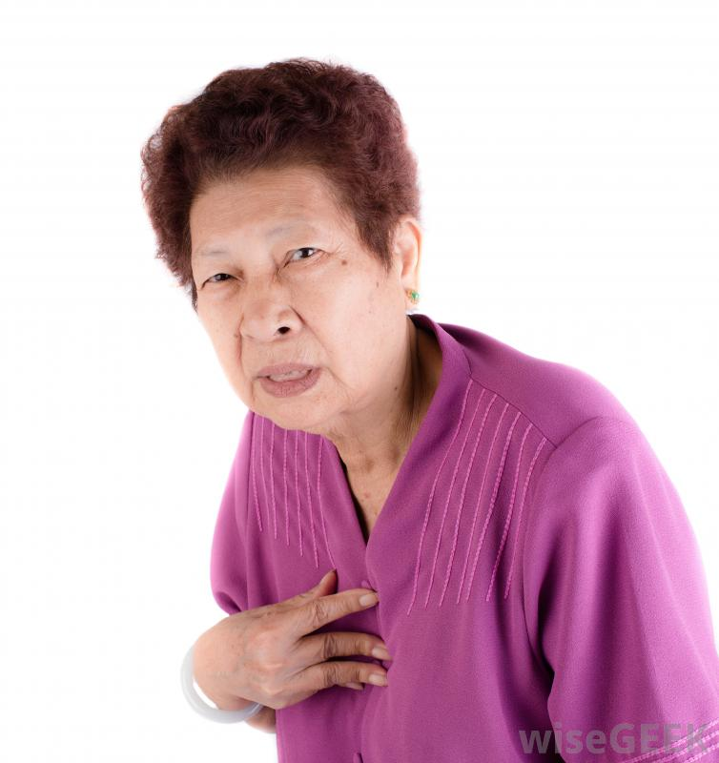
Case 1
65 yo F BIBA with…
Chest pain and SOB
Notes:
Acute pulmonary edema

Slide 9
What do you do now
Airway
She just says, “Doc!” and gestures uncomfortably
Breathing
Tachypneic, supracostal retractions, diffuse rhonchi and coarse breath sounds bilaterally
Circulation
Regular rate, tachycardia, 2/6 systolic murmur diffusely heard. Pulses strong in all 4 extremities. She nods her head, “yes” when you ask her if she’s having trouble breathing.
Notes:
(CAN YOU ADD IN ACTION ITEMS WHERE YOU CLICK AND DIFFERENT THINGS APPEAR..LIKE ASK- WHAT KINDS OF THINGS DO YOU LOOK FOR IN HER AIRWAY…IS SHE SPEAKING, DO YOU SEE ANY OBSTRUCTION..ETC. THEN ASK, WHAT DO YOU LOOK FOR FOR BREATHING- RESP RATE, BREATH SOUNDS, WORK OF BREATHING, EXTRAMUSCLE USE…ETC).

Slide 10
Next?
HR: 130
BP: 225/125
RR: 34
Oral temp: 99.8
O2 Sat: 93% on 2L NC
Notes:
Ask students for comments/interpretation.

Slide 11
History (Limited)
EMS: 65 yo F w/ h/o HTN, CAD, extensive smoking history, has been awake all night with SOB. She had been having increasing DOE x many months, has been coughing, has been having intermittent stabbing chest pain, and has been feeling sick with a fever recently. EMS gave aspirin and nebs.
Notes:
Again, ask students for comments/interpretation.

Slide 12
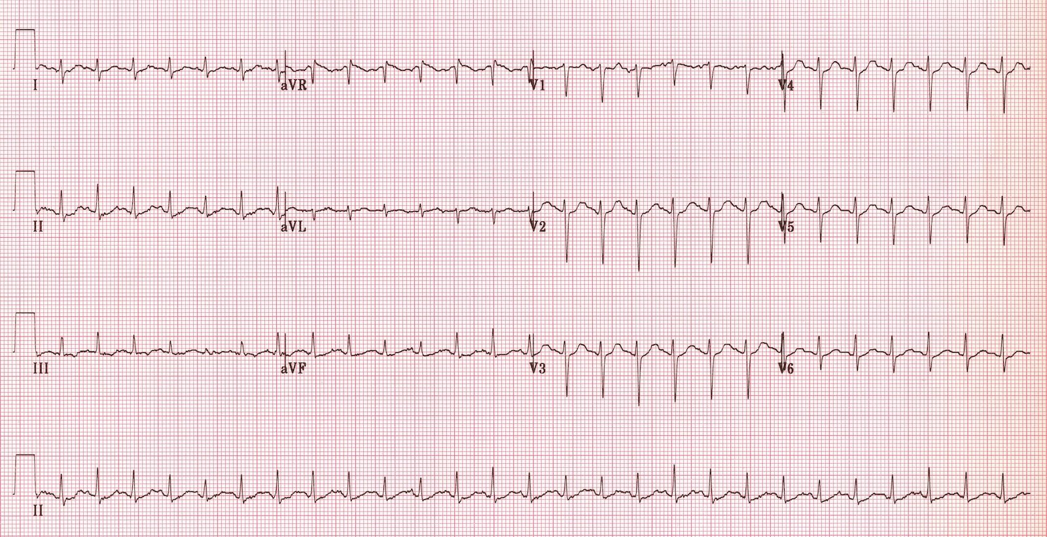
Now what?

Slide 13
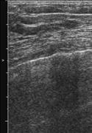
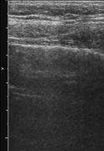
What next?

Slide 14
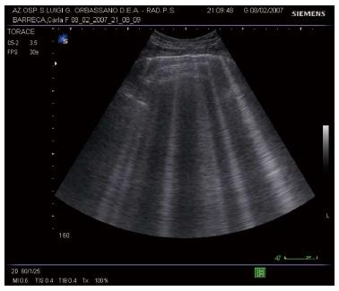
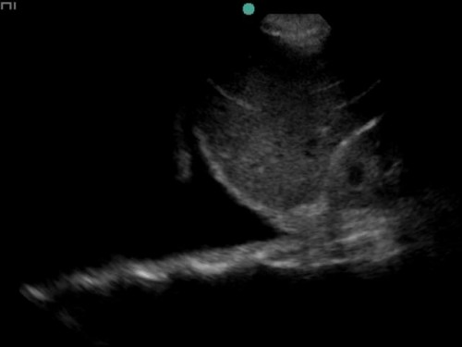
This one?
Notes:
(AGAIN, MAYBE ACTION LINK AFTER THE WHAT NEXT AND SEE WHAT THEY WANT?) Again, not entirely sure what you are thinking.

Slide 15
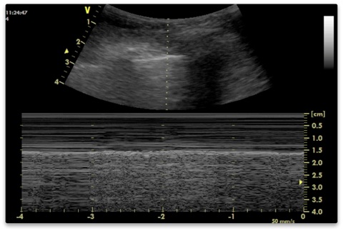
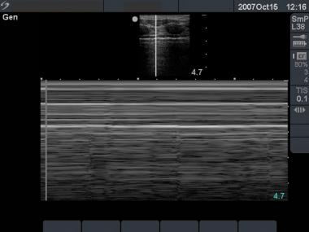
Or these
Notes:
(DO YOU HAVE AN A VIDEO CLIP OF LUNG SLIDDING. DO YOU HAVE M MODE OF SEASHORE SIGN VS BARCODE SIGN?)

Slide 16
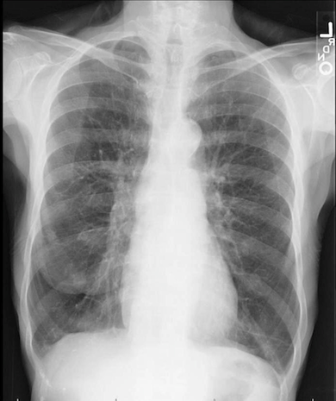
CXR?

Slide 17
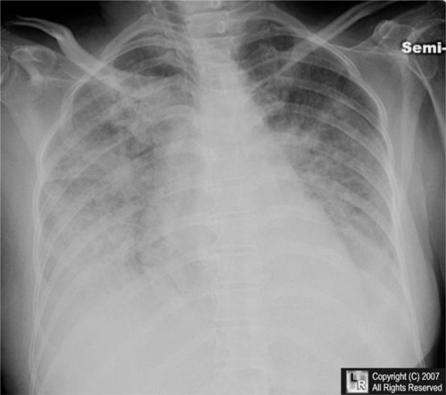
Notes:
Ask a student to interpret XR.
Pulmonary edema.

Slide 18
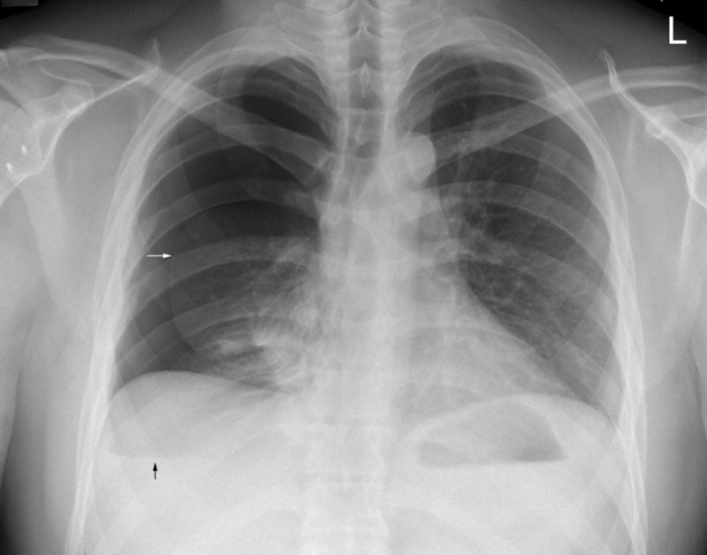

Slide 19
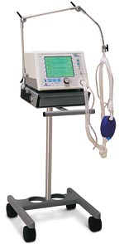
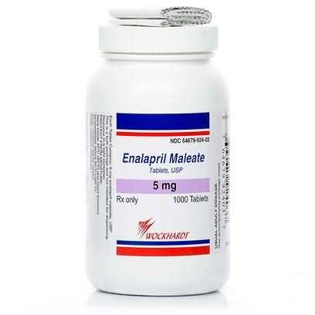
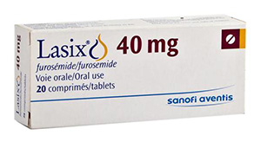
Management: too much water
Notes:
Discuss mechanisms of BiPAP (CPAP), NTG, ACE-I, diuretics in APE treatment. Also, don’t forget ASA.
(SO WHAT IS THE MANAGEMENT?)

Slide 20
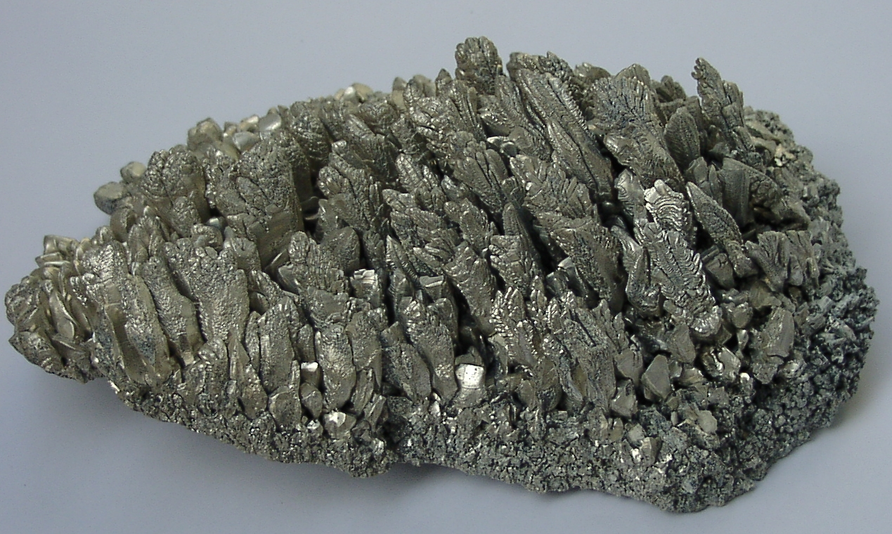
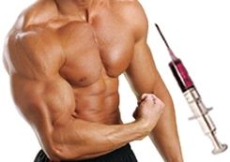
Management: too much inflammation

Slide 21
Any other tests?
What labs do you want and why? Need a reason for each test!
Shock panel
CBC
CMP
BNP
Troponin

Slide 22
Disposition?
CCU/ICU
Intensive monitoring or drips
Tele
Floor
Home

Slide 23
