Slide 1
Abdominal Pain
Luke Donnelly, MD
Emergency Medicine

Slide 2
Objectives
Approach to abdominal pain
Evaluation
Critical diagnoses and treatments

Slide 3
Abdominal Pain
Most Common ER Complaint
Broad Differential
Can often be indicative of illness involving other systems (MI, PNA, sepsis)
Focus on intrinsic causes of abd pain
Notes:
Chest pain is the second most common ED complaint, making up 10% of all ED visits or more than 6 million visits per year. Of those visits, less than half are found to have a cardiac etiology, specifically ACS.
As you know, heart disease is the leading cause of death in the US, making it a can't miss diagnosis.
That being said, CP has many etiologies and thus is a diagnostic challenge.
2% of MIs undiagnosed and discharged from ED
However, the mortality and morbidity associated with a missed diagnosis (as well as the medico-legal ramifications) means that we must view chest pain as ACS (or aortic dissection, or PE, or PTX) until proven otherwise.

Slide 4
Causes of abdominal pain
?

Slide 5
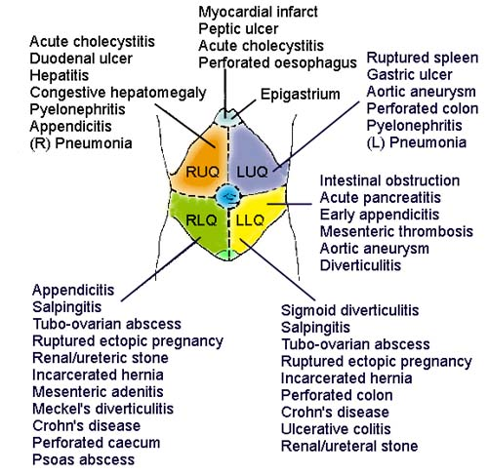
Causes of abdominal pain
Notes:
Wide range of etiologies
History is your best tool
MSK 36%
GI 19%
ACS 11%
Other cardiac (AD, AS, pericarditis) 4%
Pulmonary 5%
Psychosocial 7%
Nonspecific 16%
Of these, WHICH ONES CAN KILL? [GROUP]

Slide 6
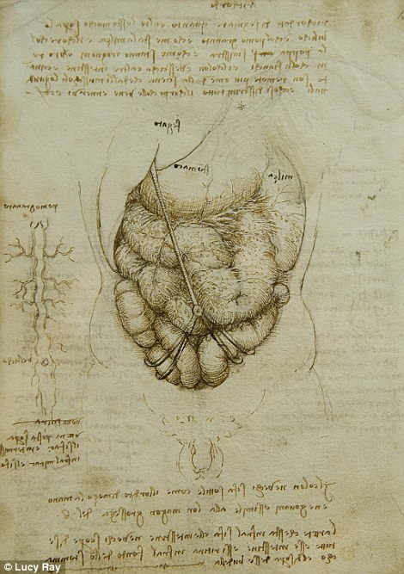
Critical diagnoses
Appendicitis
AAA
Small Bowel Obstruction
Cholycystitis
Pancreatitis
Ectopic Pregnancy
Ovarian Torsion
Notes:
Some others: Pulmonary HTN, pneumonia, myocarditis/pericarditis with tamponade

Slide 7
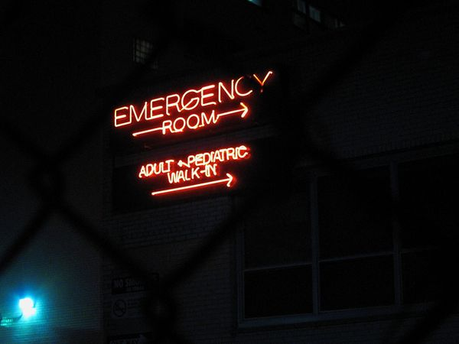
Initial assessment
Primary survey
ABC, IV, O2, Monitor
Abnormal vitals
General appearance
Urine HCG
Notes:
Resuscitate
Look at the patient. Are they in acute distress?
Is yes, your diagnosis and treatment may need to occur simultaneously with resuscitating the patient.
Patients with a thoracic aorta dissection may be hypotensive and in shock.
Patients who are fluid overloaded from heart failure, the result of a massive heart attack may not be able to properly ventilate.

Slide 8
History
Provocation/Palliation
Quality
Region/radiation
Severity
Timing
Associated Symptoms
Last BM/LMP/Last Meal
Notes:
P: what makes it better or worse (exertion, movement, position, breathing, food, drugs), what brings on the pain
Q: describe the pain for me (dull, sharp, burning, tearing) and pattern (intermittent, constant, worsening)
R: location (L,R,central), radiation to neck, shoulder, jaw, arms, back, abdomen
S: scale 1-10
T: onset (abrupt, after trauma), previous h/o similar pain (burning after eating, PUD)
Associated sx: diaphoresis, SOB, N/V, fever/chills, cough, syncope, DOE, food intolerance, psych

Slide 9
History
PMH
PSH
Meds/All
Fam Hx
Soc Hx
Notes:
PMH: DM, HTN, HLD, CAD, history of MI/DVT/PE
PSH: cardiac cath with stents, pacemaker or AICD, CABG, valve repair, congenital heart disease
Meds: cardiac meds, nitro, asa, plavix, coumadin
Fam Hx: early MI, sudden death, DVT, PE
Soc Hx: smoking, cocaine (6% of cocaine chest pain have AMI), alcoholic

Slide 10
Physical exam
General
Vitals
Lungs
Abdomen by quadrant
Check for rebound/guarding/distention
Check for pulsatile masses
Pelvic Exam
Notes:
General: distress, diaphoresis, posture
Heart: sounds, murmur, muffled, regular, friction rub, S3/4
Lung: equal bilaterally, rales, rhonchi
Neck: JVD
Abdomen: distension
Legs: edema, unilateral leg swelling, calf tenderness
Skin: Herpes zoster
Beck’s triad: hypotension, JVD, muffled heart sounds (cardiac tamponade)

Slide 11
EMS brings in patient
Notes:
What do you do?
Initial goal is to identify life-threatening events (MI, Aortic dissection, PE, PTX, esophageal rupture)
ABC, IV, O2, monitor

Slide 12
Minute 1
Initial assessment/ABCs
Vital signs
IV, O2, Monitor
EMS history
Notes:
goal:identify life-threatening diagnoses

Slide 13
Minute 5
What kind of history do you want?
Any tests?
Any medications?
Notes:
History from patient or family: SAMPLE
Tests: ECG, portable CXR
Meds: Aspirin, nitroglycerin

Slide 14
Minute 5
SAMPLE history
If female under 50-urine HCG
ECG, US of aorta
Belly labs-(CBC, CMP, Lipase,VBG, UA)
Medications:
Vomiting-Zofran
Indigestion/Heartburn-Pepcid
Pain-Morphine
Notes:
Tests: ECG, portable CXR
Meds: Aspirin, nitroglycerin
History from patient or family: SAMPLE
Goal is to stratify patient

Slide 15
Be very worried if
OR

Slide 16
Minute 15
Pt is stabilized, initial data gathered, labs and imaging ordered.
Meds ordered to address symptoms
Begin refining differential
-Use EKG, US, Urine HCG, Vitals

Slide 17
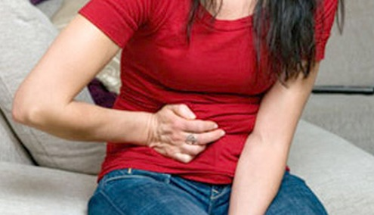
Case 1
33 y/o F with no PMH presents
with RLQ pain. Exam reveals TTP
in RLQ with guarding.
Notes:
ECG
What are you looking for on the ECG?
Signs of ACS: AMI, signs of ischemia

Slide 18
Differential
Appendicitis
Ovarian Torsion
Ectopic Pregnancy
Kidney Stone
AAA
Notes:
ECG
What are you looking for on the ECG?
Signs of ACS: AMI, signs of ischemia

Slide 19
Findings
Gradual Onset, +nausea, +anorexia
WBC 12, Hb-14, Lipase-nml, Alk Phos-nml
HCG--Negative
US: normal Aorta
Other Imaging?
Notes:
5% of patients with AMI have normal ECGs

Slide 20
CT
Notes:
5% of patients with AMI have normal ECGs

Slide 21
Appendicitis
Symptoms
Right lower quadrant pain/Periumbilical Pain
Loss of appetite
Vomiting
Exam
RLQ tenderness
Fever
+/- rebound
Notes:
Thrombus or embolus in pulmonary artery
90% from DVT
RF: prolonged immobilization, cancer, coagulopathy
PE: tachycardia, tachypnea
Ultrasound

Slide 22
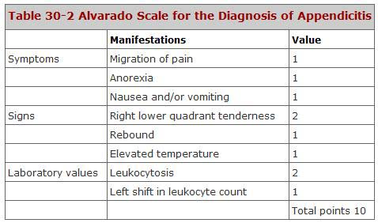

Slide 23
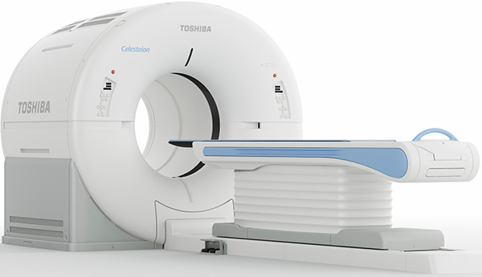
Appendicitis
Test of Choice
Management
Surgery Consult
NPO
Fluids
Morphine
Abx
Notes:
Thrombus or embolus in pulmonary artery
90% from DVT
RF: prolonged immobilization, cancer, coagulopathy
PE: tachycardia, tachypnea
Ultrasound

Slide 24
Case 2
33 y/o F with no PMH presents
with RLQ pain. Exam reveals TTP
in RLQ with guarding.
Notes:
ECG
What are you looking for on the ECG?
Signs of ACS: AMI, signs of ischemia

Slide 25
Differential
Appendicitis
Ovarian Torsion
Ectopic Pregnancy
Kidney Stone
AAA
Notes:
ECG
What are you looking for on the ECG?
Signs of ACS: AMI, signs of ischemia

Slide 26
Findings
Gradual Onset, +nausea, +anorexia
WBC 12, Hb-14, Lipase-nml, Alk Phos-nml
Urine HCG--POSITIVE
Quant Beta HCG-5,000
Next Step?
Notes:
5% of patients with AMI have normal ECGs

Slide 27
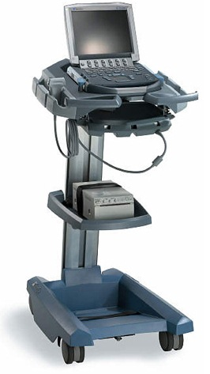
Ectopic Pregnancy-Likelihood Ratios
CMT-4.9
Adnexal mass-2.4
Adnexal tenderness 1.9
Ultrasound-111
No IUP on US in pregant patient is ectopic until proven otherwise

Slide 28
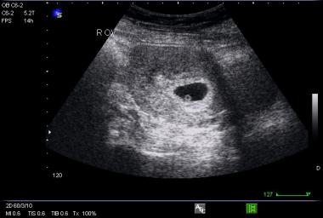
IUP

Slide 29
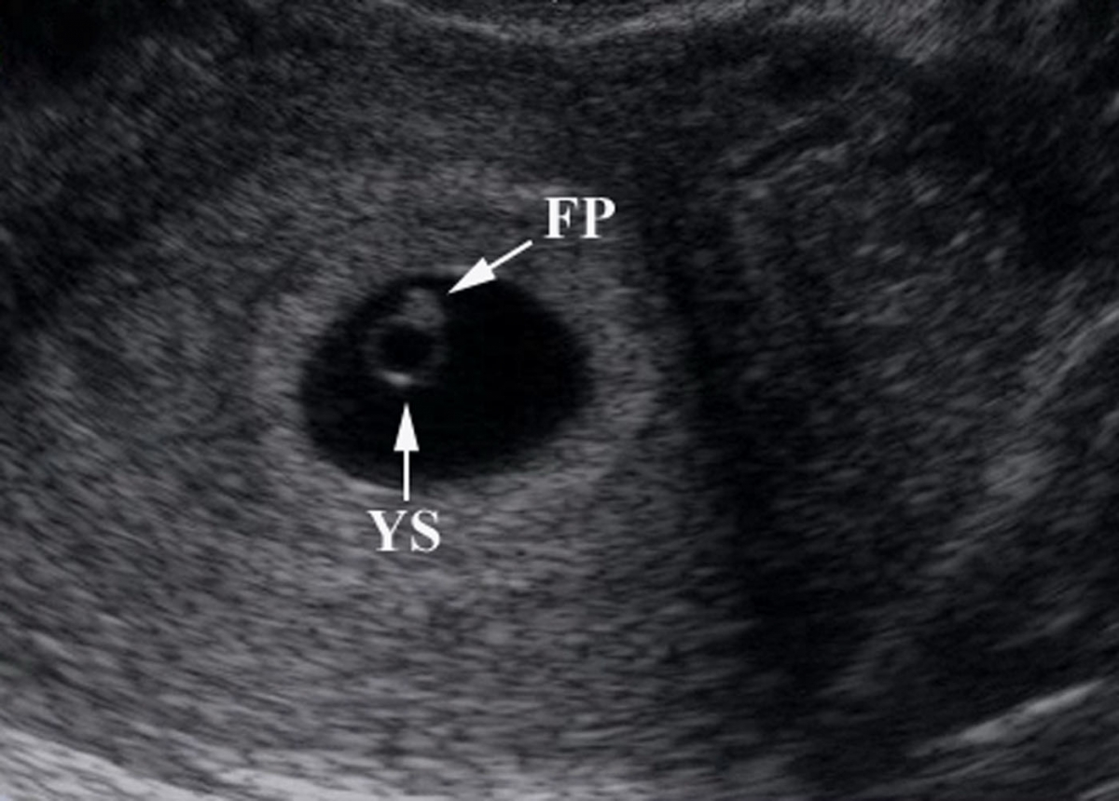
IUP

Slide 30
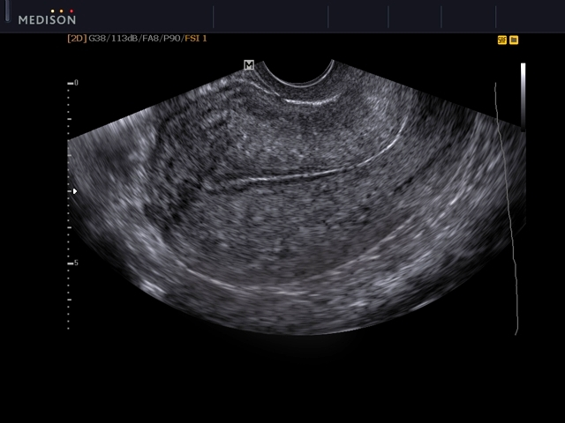
NO IUP

Slide 31
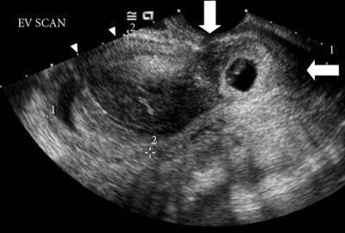
Ectopic

Slide 32
Ectopic Pregnancy
Symptoms
Abdominal Pain
Syncope
Vaginal Bleeding
Vomiting
Exam
Lower abdominal tenderness
Adnexal TTP
CMT
Peritoneal Abdomen
Notes:
Thrombus or embolus in pulmonary artery
90% from DVT
RF: prolonged immobilization, cancer, coagulopathy
PE: tachycardia, tachypnea
Ultrasound

Slide 33
Ectopic Pregnancy
Labs
Quant B-HCG, CBC, Coags, Type and Screen
-very low B-HCG cannot rule out ectopic
Management
-STAT GYN consult
-NPO
-Medical vs Surgical Management
Notes:
Thrombus or embolus in pulmonary artery
90% from DVT
RF: prolonged immobilization, cancer, coagulopathy
PE: tachycardia, tachypnea
Ultrasound

Slide 34
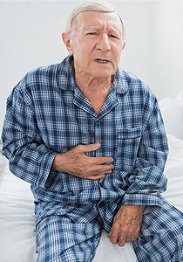
Case 3
72 y/o M presents with abdominal pain, and back pain. Exam shows BP of 90/60 and a pulsatile mass in the abdomen.
Next Step???
Notes:
ECG
What are you looking for on the ECG?
Signs of ACS: AMI, signs of ischemia

Slide 36
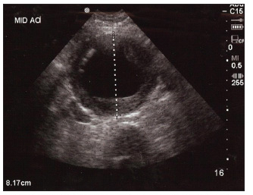
>3cm-abnormal

Slide 37
AAA
Risk Factors
Smoking
Male Gender
Age over 65
HTN
HLD
Symptoms
Abd, Flank or Back Pain-can mimic renal colic
Syncope or Dizziness-due to low BP
Notes:
Thrombus or embolus in pulmonary artery
90% from DVT
RF: prolonged immobilization, cancer, coagulopathy
PE: tachycardia, tachypnea
Ultrasound

Slide 38
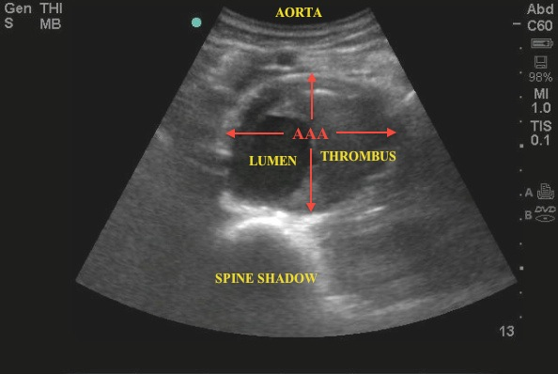
AAA
Risk Factors
Smoking
Male Gender
Age over 65
HTN
HLD
Symptoms
Abd, Flank or Back Pain-can mimic renal colic
Syncope or Dizziness-due to low BP
Notes:
Thrombus or embolus in pulmonary artery
90% from DVT
RF: prolonged immobilization, cancer, coagulopathy
PE: tachycardia, tachypnea
Ultrasound

Slide 39
AAA
Tests
US is test of choice
CT is useful for surgeons to plan procedure
CBC
Type and Screen-transfuse if ruptured
Pre op labs
Management-Rupture
Surgical Repair
Volume resuscitation
Target Systolic 90-100
Notes:
Thrombus or embolus in pulmonary artery
90% from DVT
RF: prolonged immobilization, cancer, coagulopathy
PE: tachycardia, tachypnea
Ultrasound

Slide 40
Case 4
72 y/o M h/o appendectomy presents with diffuse abdominal pain and vomiting.
Vitals: 156/90 88 20 98.2 98%
Notes:
ECG
What are you looking for on the ECG?
Signs of ACS: AMI, signs of ischemia

Slide 41
Differential
Pancreatitis
SBO
MI
Sepsis
Gastritis
Gastroenteritis
Colitis
Cholangitis
SBP
AAA
UTI
Perforated Viscous
GI bleed
Notes:
ECG
What are you looking for on the ECG?
Signs of ACS: AMI, signs of ischemia

Slide 42
Findings
Last BM 3 days ago
Vomiting green liquid
Exam:
-Belly distended, diffusely ttp
-Tympanic
Labs:
-lactate 4.6
-WBC 13, Hb 15, Lipase nml
Notes:
5% of patients with AMI have normal ECGs

Slide 43
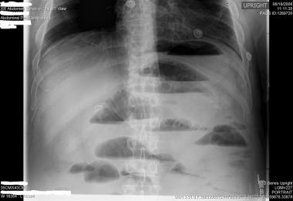
Diagnosis
Small Bowel Obstruction
Notes:
5% of patients with AMI have normal ECGs

Slide 44
SBO
Test of Choice?
Notes:
5% of patients with AMI have normal ECGs

Slide 45
SBO
Management
-Gastric Decompression (NG Tube)
-IV fluids
-Anti emetics
-Pain Control
-NPO
-Surgery consult
Notes:
Thrombus or embolus in pulmonary artery
90% from DVT
RF: prolonged immobilization, cancer, coagulopathy
PE: tachycardia, tachypnea
Ultrasound

Slide 46
Case 5
48 y/o F no pmh, presents with epigastric and RUQ pain, fever and vomiting
Vitals: 150/90 88 20 100.5 98%
Notes:
ECG
What are you looking for on the ECG?
Signs of ACS: AMI, signs of ischemia

Slide 47
DDX
Cholecystitis
Cholangitis
Hepatitis
Pancreatitis
Gastritis
Pyelonephritis
Perforated Ulcer
Notes:
ECG
What are you looking for on the ECG?
Signs of ACS: AMI, signs of ischemia

Slide 48
Findings
Symptoms for 10 hours, began after eating
Exam:
- RUQ TTP
- +Murphy's sign
Labs:
-WBC 14, Lipase nml, lactate 2.4, Alk Phos-274
-AST 224 ALT 198
Notes:
5% of patients with AMI have normal ECGs

Slide 49
Next Step?

Slide 50
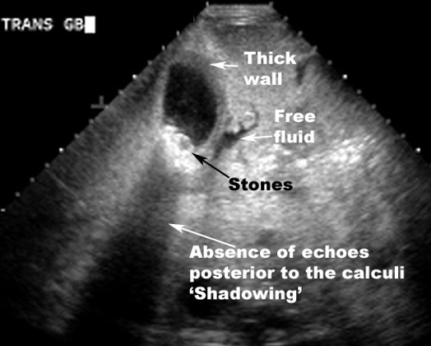

Slide 51
Cholecystitis
Risk Factors
-gallstones
-female gender
-obesity
Symptoms/Exam
-RUQ pain and tenderness
-no one finding can make diagnosis
Notes:
Thrombus or embolus in pulmonary artery
90% from DVT
RF: prolonged immobilization, cancer, coagulopathy
PE: tachycardia, tachypnea
Ultrasound

Slide 52
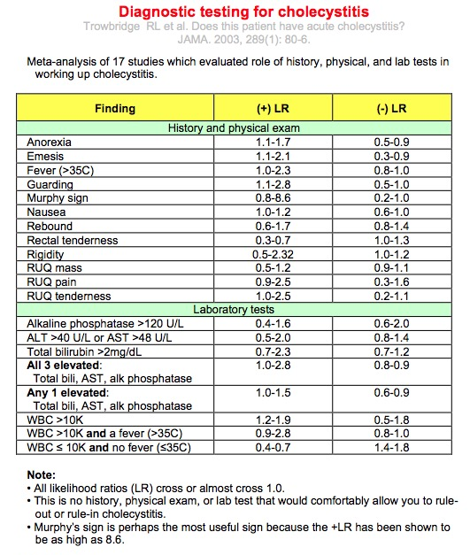
Notes:
Thrombus or embolus in pulmonary artery
90% from DVT
RF: prolonged immobilization, cancer, coagulopathy
PE: tachycardia, tachypnea
Ultrasound

Slide 53
Cholecystitis
Management
-infection so if septic treat accordingly
-Iv abx (zosyn)
-Fluids
-NPO
-STAT surgery consult
Notes:
Thrombus or embolus in pulmonary artery
90% from DVT
RF: prolonged immobilization, cancer, coagulopathy
PE: tachycardia, tachypnea
Ultrasound

Slide 54
Pearls
-Have a high index of suspicion in old patients
-Every female under 50 with abd pain is ectopic until proven otherwise
-Remember ovarian, testicular torsion as alternate causes of RLQ pain
-The ultrasound is the test of choice to evaluate for AAA and cholecystitis
-All patients with suspected serious causes of abdominal pain will need imaging
Notes:
Thrombus or embolus in pulmonary artery
90% from DVT
RF: prolonged immobilization, cancer, coagulopathy
PE: tachycardia, tachypnea
Ultrasound

