Slide 1
ED Initiated Buprenorphine
& Referral to Treatment
A brief guide for ED Practitioners
Comments or questions?
Kathryn Hawk, MD, MHS
Kathryn.hawk@yale.edu
Ryan McCormack, MD, MS
Ryan.mccormack@nyulangone.org
Study email:
ED-Connect@nyulangone.org
Why the ED?
Because that’s where the patients are!
Responding to the Opioid Epidemic
Opioid-related ED visits are escalating. We are on the front lines with little preparation or tools to combat this crisis.
What can you do?
Prescribe opioids safely and judiciously
Increase access to medication treatments
Initiate buprenorphine
Provide “Warm” scheduled referrals
Offer harm reduction strategies
Overdose education and training
Naloxone Prescription
Community resources (e.g. peers)
Build trust and engage the patient
Treat with empathy and respect
We have medicine that works!
Opioid-related ED visits more than doubled in 10 years.
ED visits for overdose (OD) increased 30% from July 2016 – Sept 2017.
ED visits and surviving an OD are strong predictors of subsequent OD death.
90% of patients with substance use disorder go untreated.
ED is the only access point for healthcare for many.
We encounter patients at critical moments in their lives.
What is the evidence?
Buprenorphine (BUP) for Opioid Use Disorder (OUD) has been well-studied and clinically used for decades.
Strong evidence of BUPs effectiveness:
↓ OD, ↓Death, ↓drug use, ↓HIV/HCV, ↓ Crime
↑ Treatment engagement, ↑Social functioning quality
D’Onofrio et al. (JAMA 2015) showed BUP in the ED is feasible and safe with strong 30-day treatment effect:
Twice as likely to be in treatment
Less illicit drug use reported
What do I need to know about buprenorphine?
How does it work?
It is NOT simply replacing one drug for another
BUP reduces craving and withdrawal.
Do not give BUP until the patient is in opioid withdrawal.
BUP is a partial agonist at the mu-opioid receptor with higher affinity than full agonists. Thus, if given to too early, BUP will cause withdrawal by displacing full agonist.
It is safer than full agonists because of its “ceiling effect”.
Once at a therapeutic level, higher doses don’t cause more mu-receptor activation or CNS depression.
Patients can safely be prescribed BUP for unobserved “home” induction (if not yet in withdrawal in the ED).
(methadone, heroin)

Slide 3
Step by Step Pocket Guide to ED-initiated BUP
How do I obtain an X-waiver to prescribe BUP?
DATA waiver training for providers
https://www.samhsa.gov/medication-assisted-treatment/training-resources/buprenorphine-physician-training
https://pcssnow.org/education-training/
ACEP 2018 Scientific Assembly – September 29, 2018 (https://bit.ly/2P2Juhn)

Slide 4
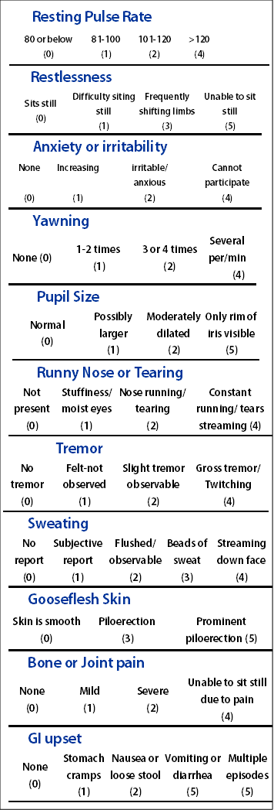
How to assess for OUD?
How to assess for withdrawal?
Questions based on DSM-5 criteria:
Have you found that when you started using, you ended up taking more than you intended to?
Have you wanted to stop or cut down on using opioids?
Have you spent a lot of time getting or using opioids?
Have you had a strong desire or urge to use opioids
Have you missed work or school or often arrived late because you were intoxicated, high or recovering from the night before?
Has your use of opioids caused problems with other people such as with family members, friends or people at work?
Have you had to give up or spend less time working, enjoying hobbies, or being with others because of your drug use?
Have you ever gotten high before doing something that requires coordination or concentration like driving, boating, climbing a ladder, or operating heavy machinery?
Have you continued to use even though you knew that the drug caused you problems like making you depressed, anxious, agitated or irritable?
Have you found you needed to use much more drug to get the same effect that you did when you first started taking it?
When you reduced or stopped using, did you have withdrawal symptoms or felt sick when you cut down or stopped using?
Moderate OUD: 4-5 symptoms
Severe OUD: 6 or more symptoms
LOSS OF CONTROL
Clinical Opioid Withdrawal Scale
(COWS)
Most providers fear talking to patients about substance use. This guide may help:
Step 1. Raise the Subject/Establish Rapport
Introduce yourself
Raise the subject of opioid use and ask permission to discuss OUD
Assess patients subjective level of physical discomfort (i.e., withdrawal)
Step 2. Provide Feedback
Review patients drug use and patterns
Ask the patient about and discuss drug use and its negative consequences
Make a connection (if possible) between drug use and visit or medical issues
Provide feedback on OUD diagnosis and treatment options (e.g., medication (BUP, methadone, naltrexone), behavioral outpatient programs, 12-step, and/or harm reduction strategies.
Step 3. Enhance Motivation
Assess readiness to change – with regard to starting preferred treatment
“On a scale of 1-10, how ready are you to start BUP right now?
Enhance Motivation
Ask a series of open-ended questions designed to evoke “Change Talk” (or motivational statements) about their target behavior.
Reflect or reiterate the patient’s motivational statements regarding entering treatment.
Step 4. Negotiate & Advise
Negotiate goal regarding the target behavior (e.g. starting BUP)
Give advice
Complete a referral/treatment or goal agreement, and secure and provide the actual referral for treatment (BUP or other)
Video example: https://www.aetna.com/health-care-professionals/patient-care-programs/impact-of-opioid-use-disorder.html
Only start BUP if COWS≥ 8.

